Slide 1
T.I.M. “Time is Money”
Employee Monitoring/Time Management Software

Slide 2
T.I.M Project Summary

Slide 3
WHAT IS T.I.M?
Time Is Money!
T.I.M is a computer software that captures and records employee data and information to track work efficiency and manage time .
Any business looking to keep an eye open while managing its network of employees, of any size, can leave worry behind with the support of T.I.M!

Slide 4
System Capabilities
Collecting and storing business and employee information
Collecting and storing business expenses
Employee website tracking
Record hours of employees per week
A customizable, user-friendly interface
Hierarchy of access to stored information and features
Mobile access

Slide 5
WHO DOES IT SERVE?
T.I.M will benefit any organization that wants to save money.
T.I.M can be adapted to provide logistic information for any organization requiring close monitoring on member involvement, activity, and time contribution.
Organizations will know that they are getting what they pay for out of an employee.
Great for companies allowing workers to telecommute.

Slide 6
BUSINESS BENEFITS
Monitor overall spending, hours spent working, and task completion
Save the company money by tracking employee hours and limiting overtime
Helps form better time management skills
Healthier work environment for employees
Higher productivity
Limiting distractions by blocking websites that should not be browsed

Slide 7
Requirements in terms of FURPS

Slide 8
Functionality - All the stuff T.I.M. needs to work
For legal reasons, the system MUST have a functioning legal disclaimer on start.
Customizable interface and separation of duties based on workplace.
Login System, generation of unique IDs for each employee.
Task organization by hour, tracks hours spent at work.
Database of employee information.
Website restriction as decided by system managers.

Slide 9
Usability - Ease of use
Simple, clean login screen.
Ability to change password and login name.
Communication on efficiency through mediums like infographics.
“Employee Reports”

Slide 10
Reliability - System Uptime
24/7 access, limited downtime.
Live support chat, F.A.Q., customer service line.
Backups and recovery

Slide 11
Performance - How efficiently everything runs
Real-time monitoring has to be supported.
System that automatically updates using minimal resources.

Slide 12
Security - Making sure people don’t steal your employee’s identities.
Employee information protection through data encryption.
Depending on organization requirements, cloud-based or on-sight storage.

Slide 13
Users and User Cases

Slide 14
Users and User Case Stories
Management
“I want to optimize the production of my business and its employees as efficiently as possible throughout the work day.”
Employee
“I want to manage my hours and check my work schedule in a clear and convenient manner.”

Slide 15
Users and User Case Stories (cont.)
Company Administrator
“I want to manage and optimize my business in a straightforward and transparent fashion.”
System Administrator
“I want to ensure T.I.M.’s benefit to workplace efficiency through collected statistics as safely and informatively as possible.”

Slide 16
Users and User Case Stories (cont.)
Live Support Administrator
“My goal is to assure business managers have the best possible experience with T.I.M., simply and quickly.”

Slide 17
User Goals
Management
Monitor and evaluate certain websites to curb improper use of time and equipment by employees.
Be able to keep track of hours and approve of hour submissions for all employees.
Obtain Employee Portfolios (Employee Report) at any time.
Authorize unique pay periods to payroll transfer: Pay by project completion, pay upon set time total, other time denominations.

Slide 18
User Goals
Employee
Log in to T.I.M. via username & password.
Check work schedule.
Organize tasks and monitor task completion.
Input overtime/work hours to be validated by management.

Slide 19
User Goals
Company Administrator
Interact with the system to edit/update employee information.
Create/ authorize new user profiles for new employees.
Edit/update company help system to increase usability (FAQ).
Retrieve system backup in a critical situation.

Slide 20
User Goals
System Administrator
Oversee the security and functionality of the system.
Implement and deliver software updates as needed.
Complete remote access capabilities.
If needed, boot recovery/backup data should the system crash at any time.

Slide 21
User Goals
Live Support Representative
Remote access with a user to help internally.
Live support chat with the client.
Real-time interaction capability.

Slide 22
Subsystems

Slide 23
Subsystems
Management Subsystem
Actors: Management, Company Admin.
User Account Subsystem
Employee, Company Admin., Management
Support Subsystem
System Admin., Live Support Representative, Company Admin.

Slide 24
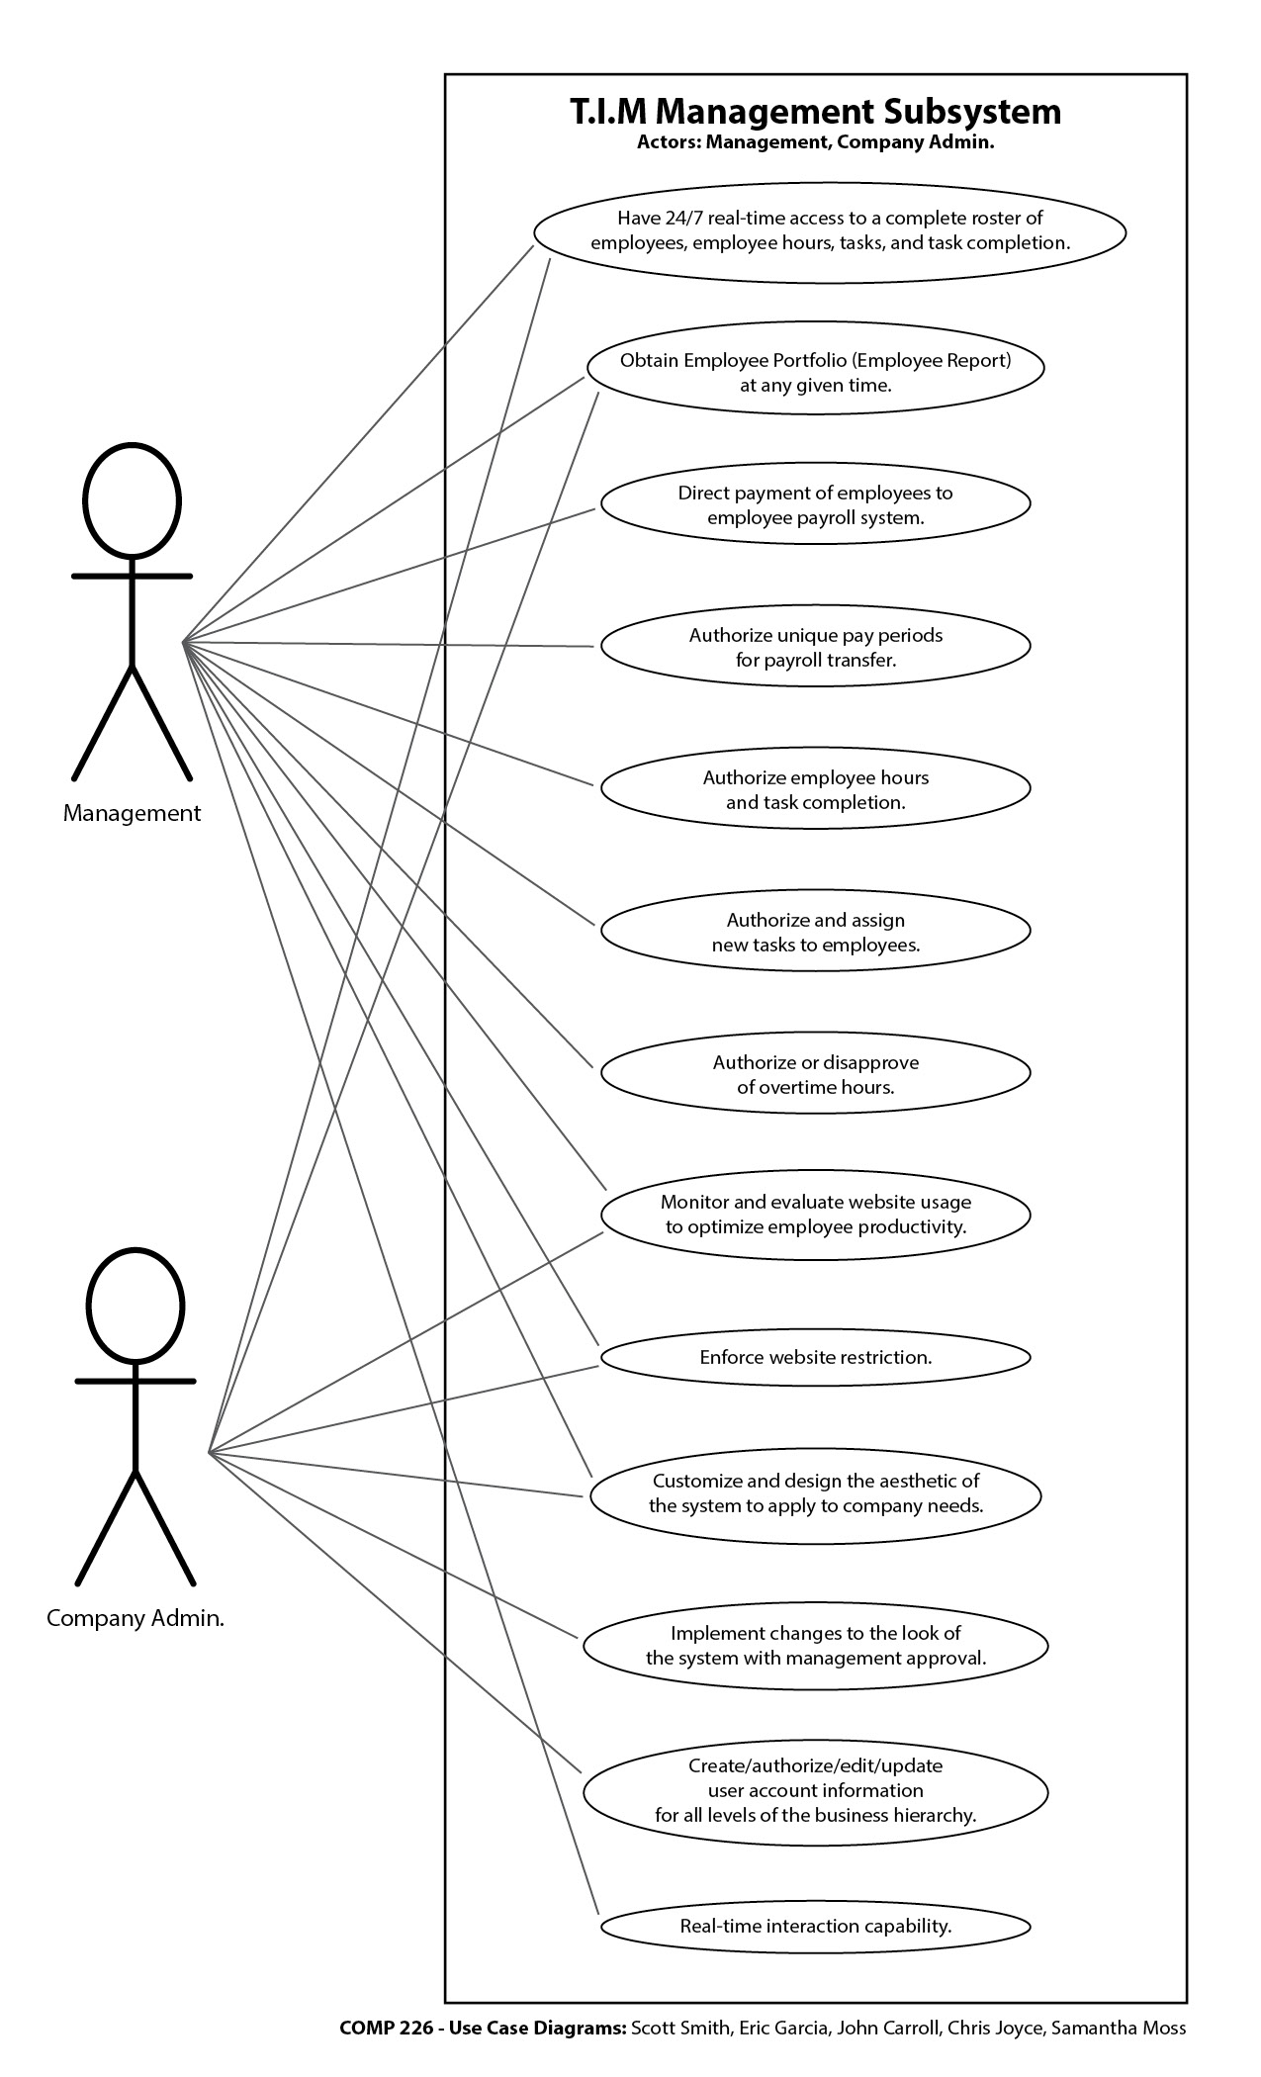
Subsystems
Management Subsystem

Slide 25
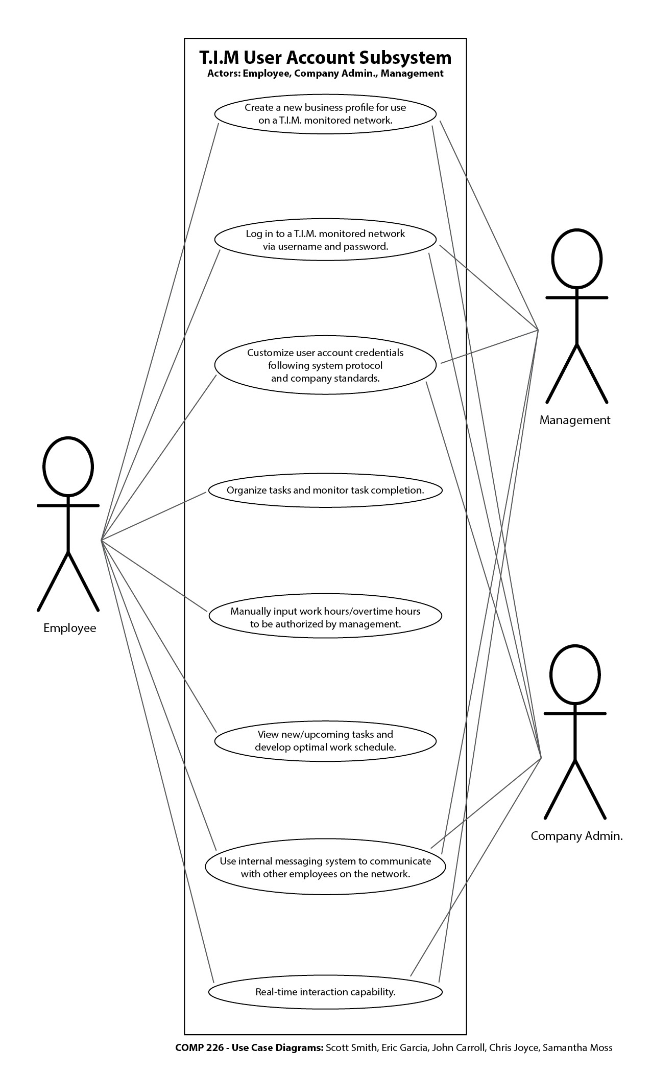
Subsystems
User Account Subsystem

Slide 26
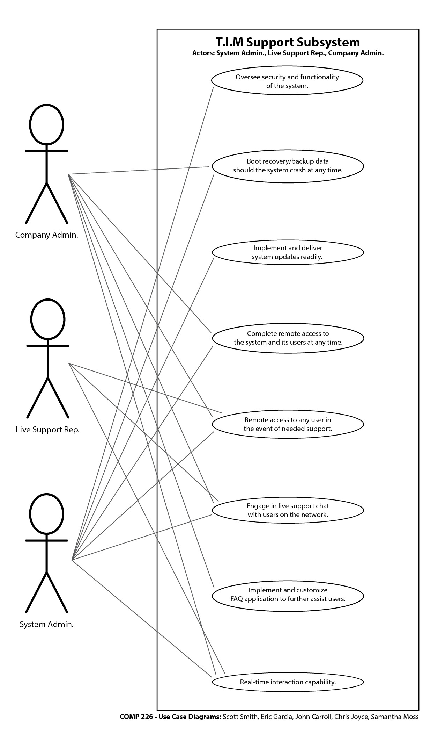
Subsystems
T.I.M. Support Subsystem

Slide 27
Class diagrams

Slide 28
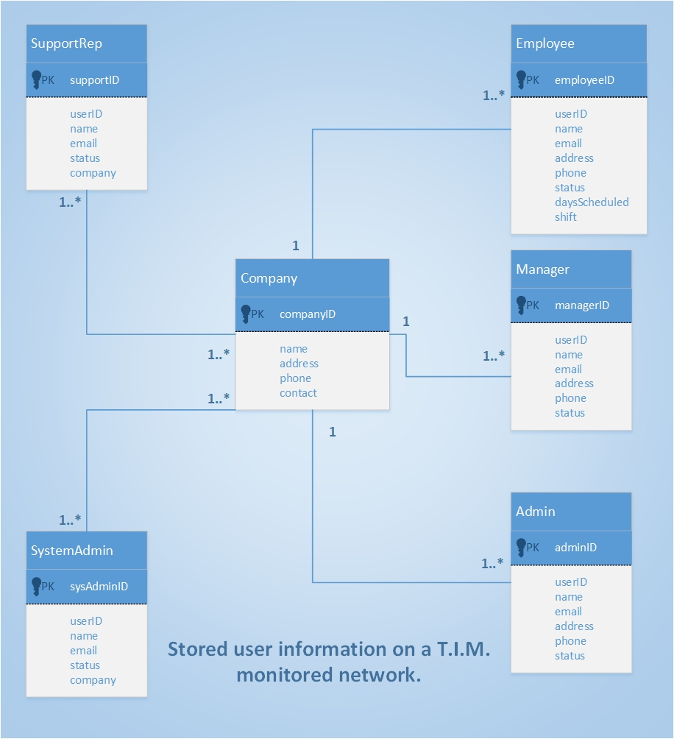

Slide 29
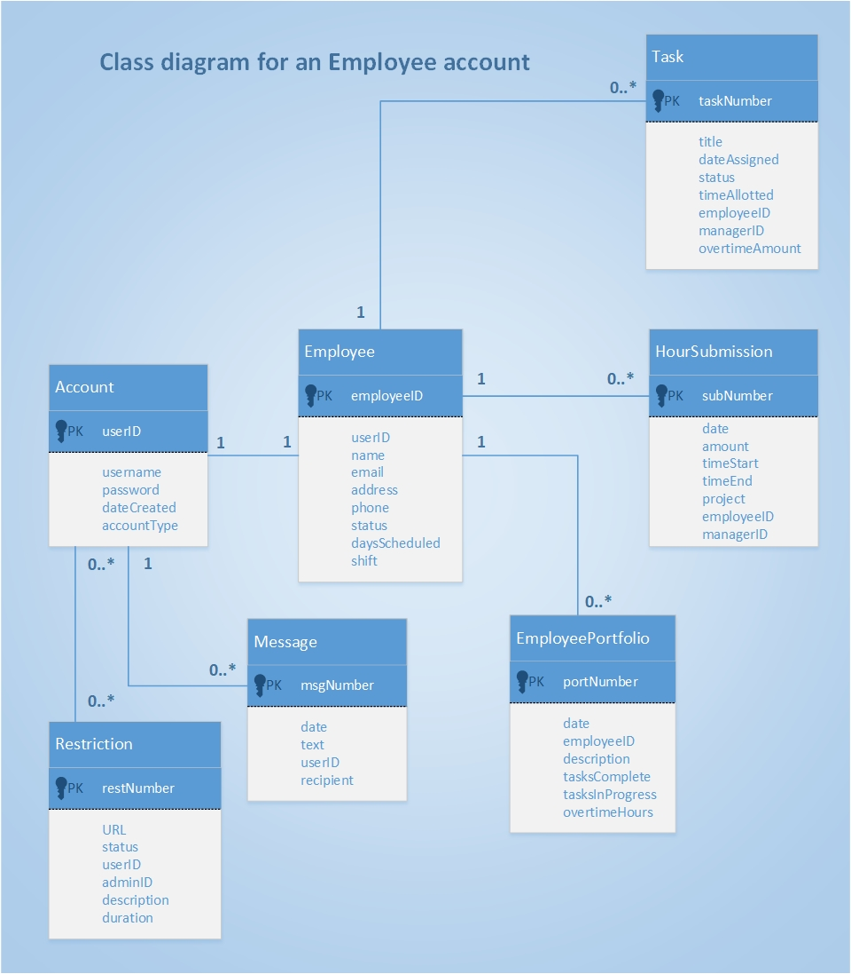

Slide 30
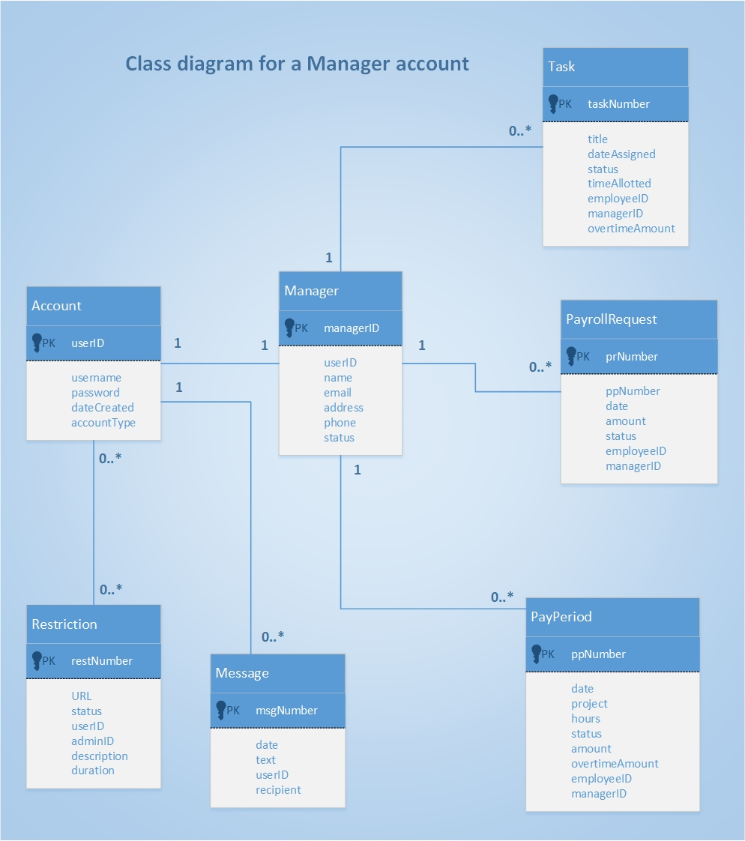

Slide 31
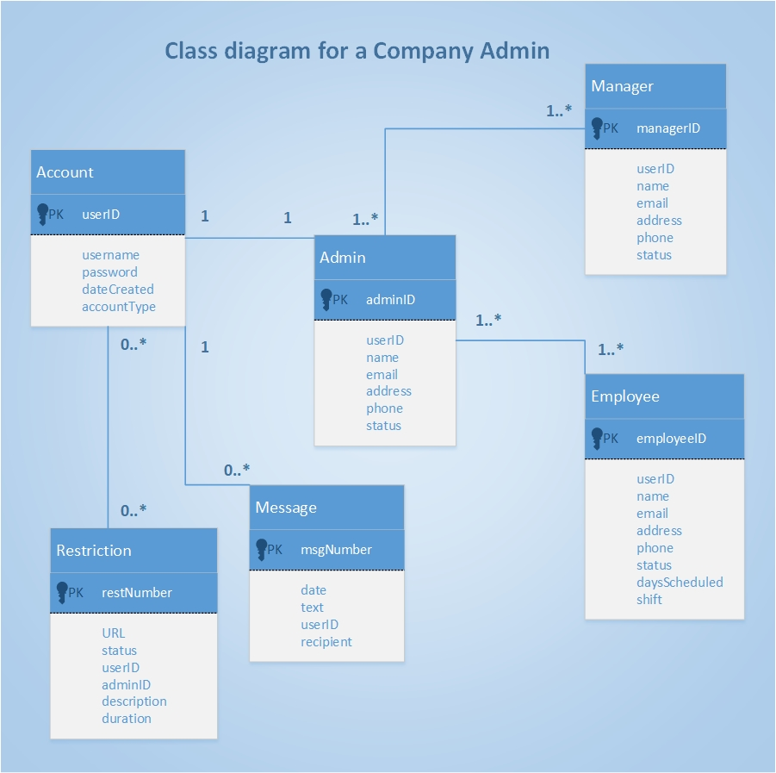

Slide 32
Application Components

Slide 33
Application components
What are the functions, boundaries, and interfaces?
T.I.M.’s scope and size is to be large enough to contain a user-friendly/customizable and intuitive interface (GUI) as well as an optimized database with real-time access to tracked company information.
Some functions that must be included:
Process employee reports
Create/edit/delete a user account
Input and assign tasks
Check work schedule and monitor tasks
Allow remote access into the system
Approve of hour submissions/Process unique pay periods

Slide 34
Language/ Build or buy
Our application T.I.M. is going to be programmed in an object-oriented format using Java. JavaFX will be used to configure the GUI
We feel building our application from scratch will give us the best design and flexibility as possible.

Slide 35
Ensuring T.I.M. will function
Separation of duties
Hierarchy of duties will be in place so that one user won't have multiple privileges . This hierarchy is structured to fit its respective workplace environment and will provide different levels of information and permissions depending on user rank in the hierarchy.
Auditing
Unique user ID #’s will be given, every user’s activity will be tracked and held for future reference and for lawful reasons.

Slide 36
Continued...
Monitoring
Real-time database tracking will allow for privileged users to view all user activity when needed. Support representatives, system admins, and company admins will also have remote-access to user accounts on the T.I.M. network to afford more precision in monitoring.
Asset Control
Critical company information and data will require additional protection through encryption. Payroll transfers will be transmitted to a company’s respective payroll system through HTTPS on a secure TLS channel for enhanced security.

Slide 37
Continued...
Security
Protection of vital company and user data will be guaranteed through use of SHA-256 encryption. User passwords will be protected using AES-256 bit encryption.
Physical security will be set in place at company database locations if we choose not to utilize Storage as a Service

Slide 38
Architecture Diagrams

Slide 39
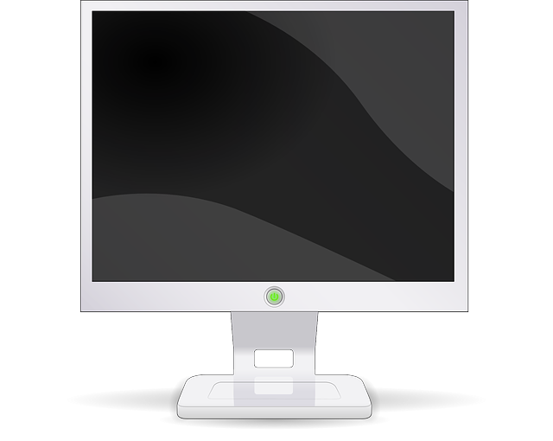
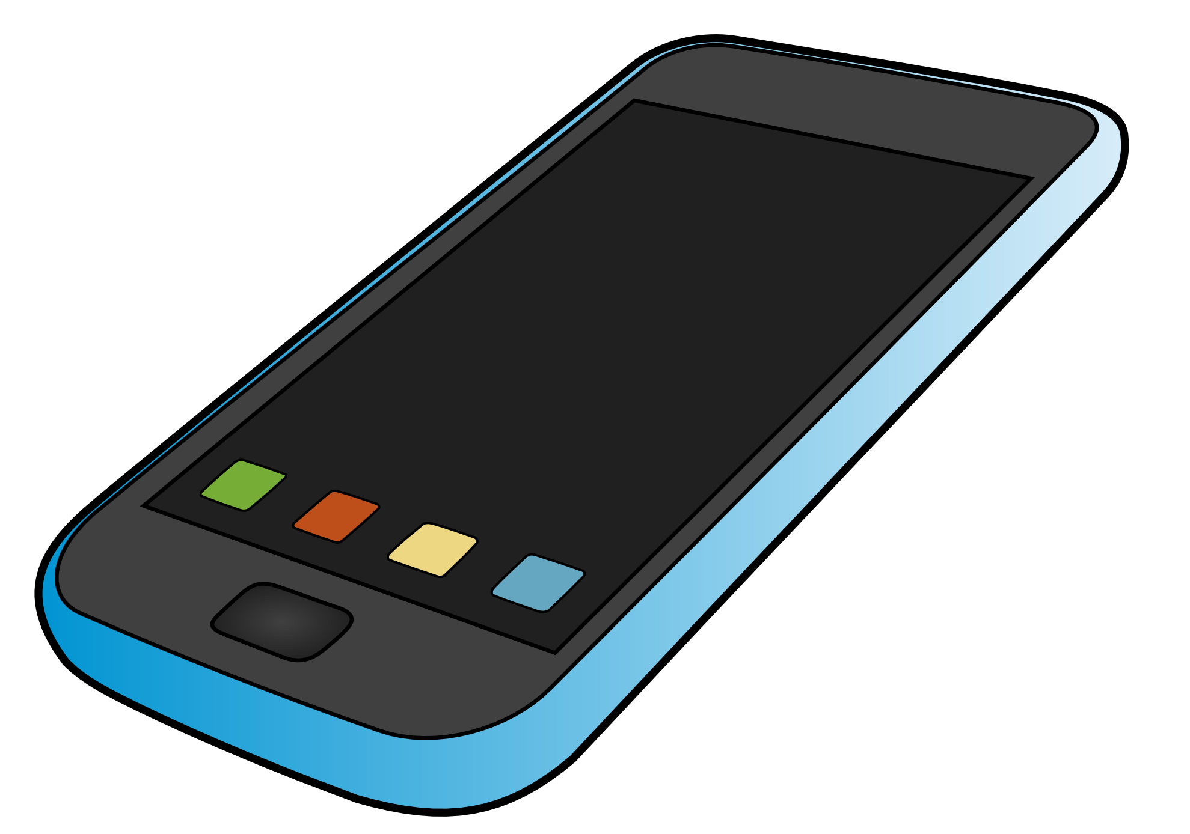
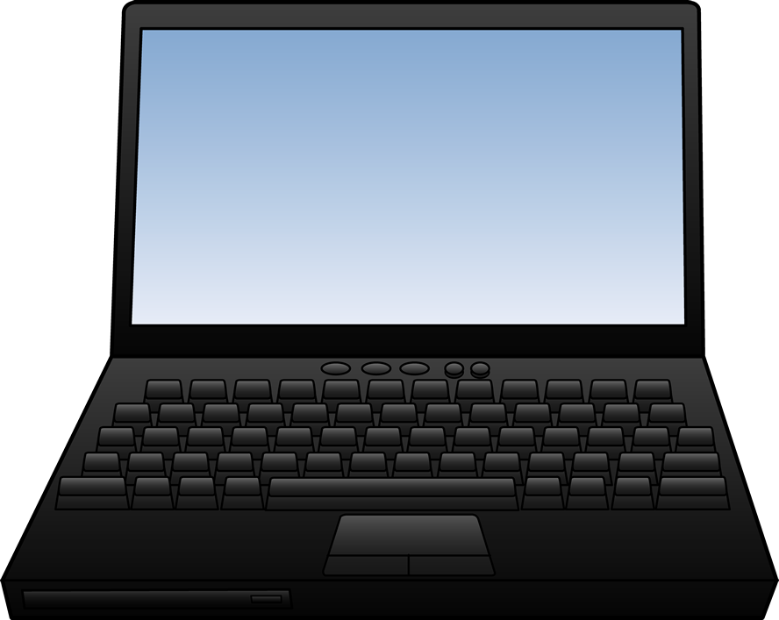
View Layer
Customizable GUI Interface
Viewed/Accessed via desktop, laptop, and mobile clients
-----------------------------------------------------
View hours/schedules, calendar, tasks, reports, company roster/account information, staff contact details (work email, telephone extension), client contact details
Log-in screen for username and password input
View messaging system and live-chat support

Slide 40
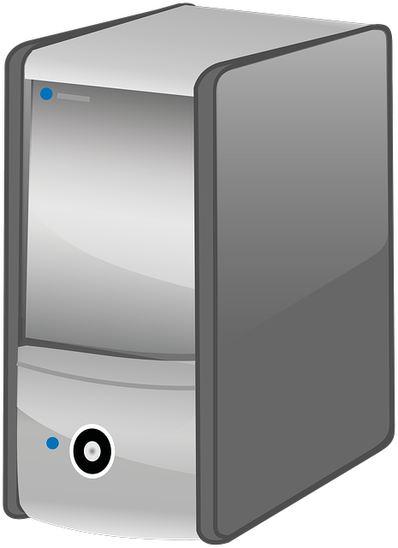
Domain Layer
Web/Application Server
-----------------------------------------------------
Hierarchy rules of access; Different business role subsystems have different access to data and features
Update account info, Create/Delete account info, Create/Update task info, Customize the look of GUI, Input/Authorize hours, Process payroll transfers, Input website restriction, Access staff contact details (work email, telephone extension), Access to client contact details, Access live-chat support

Slide 41
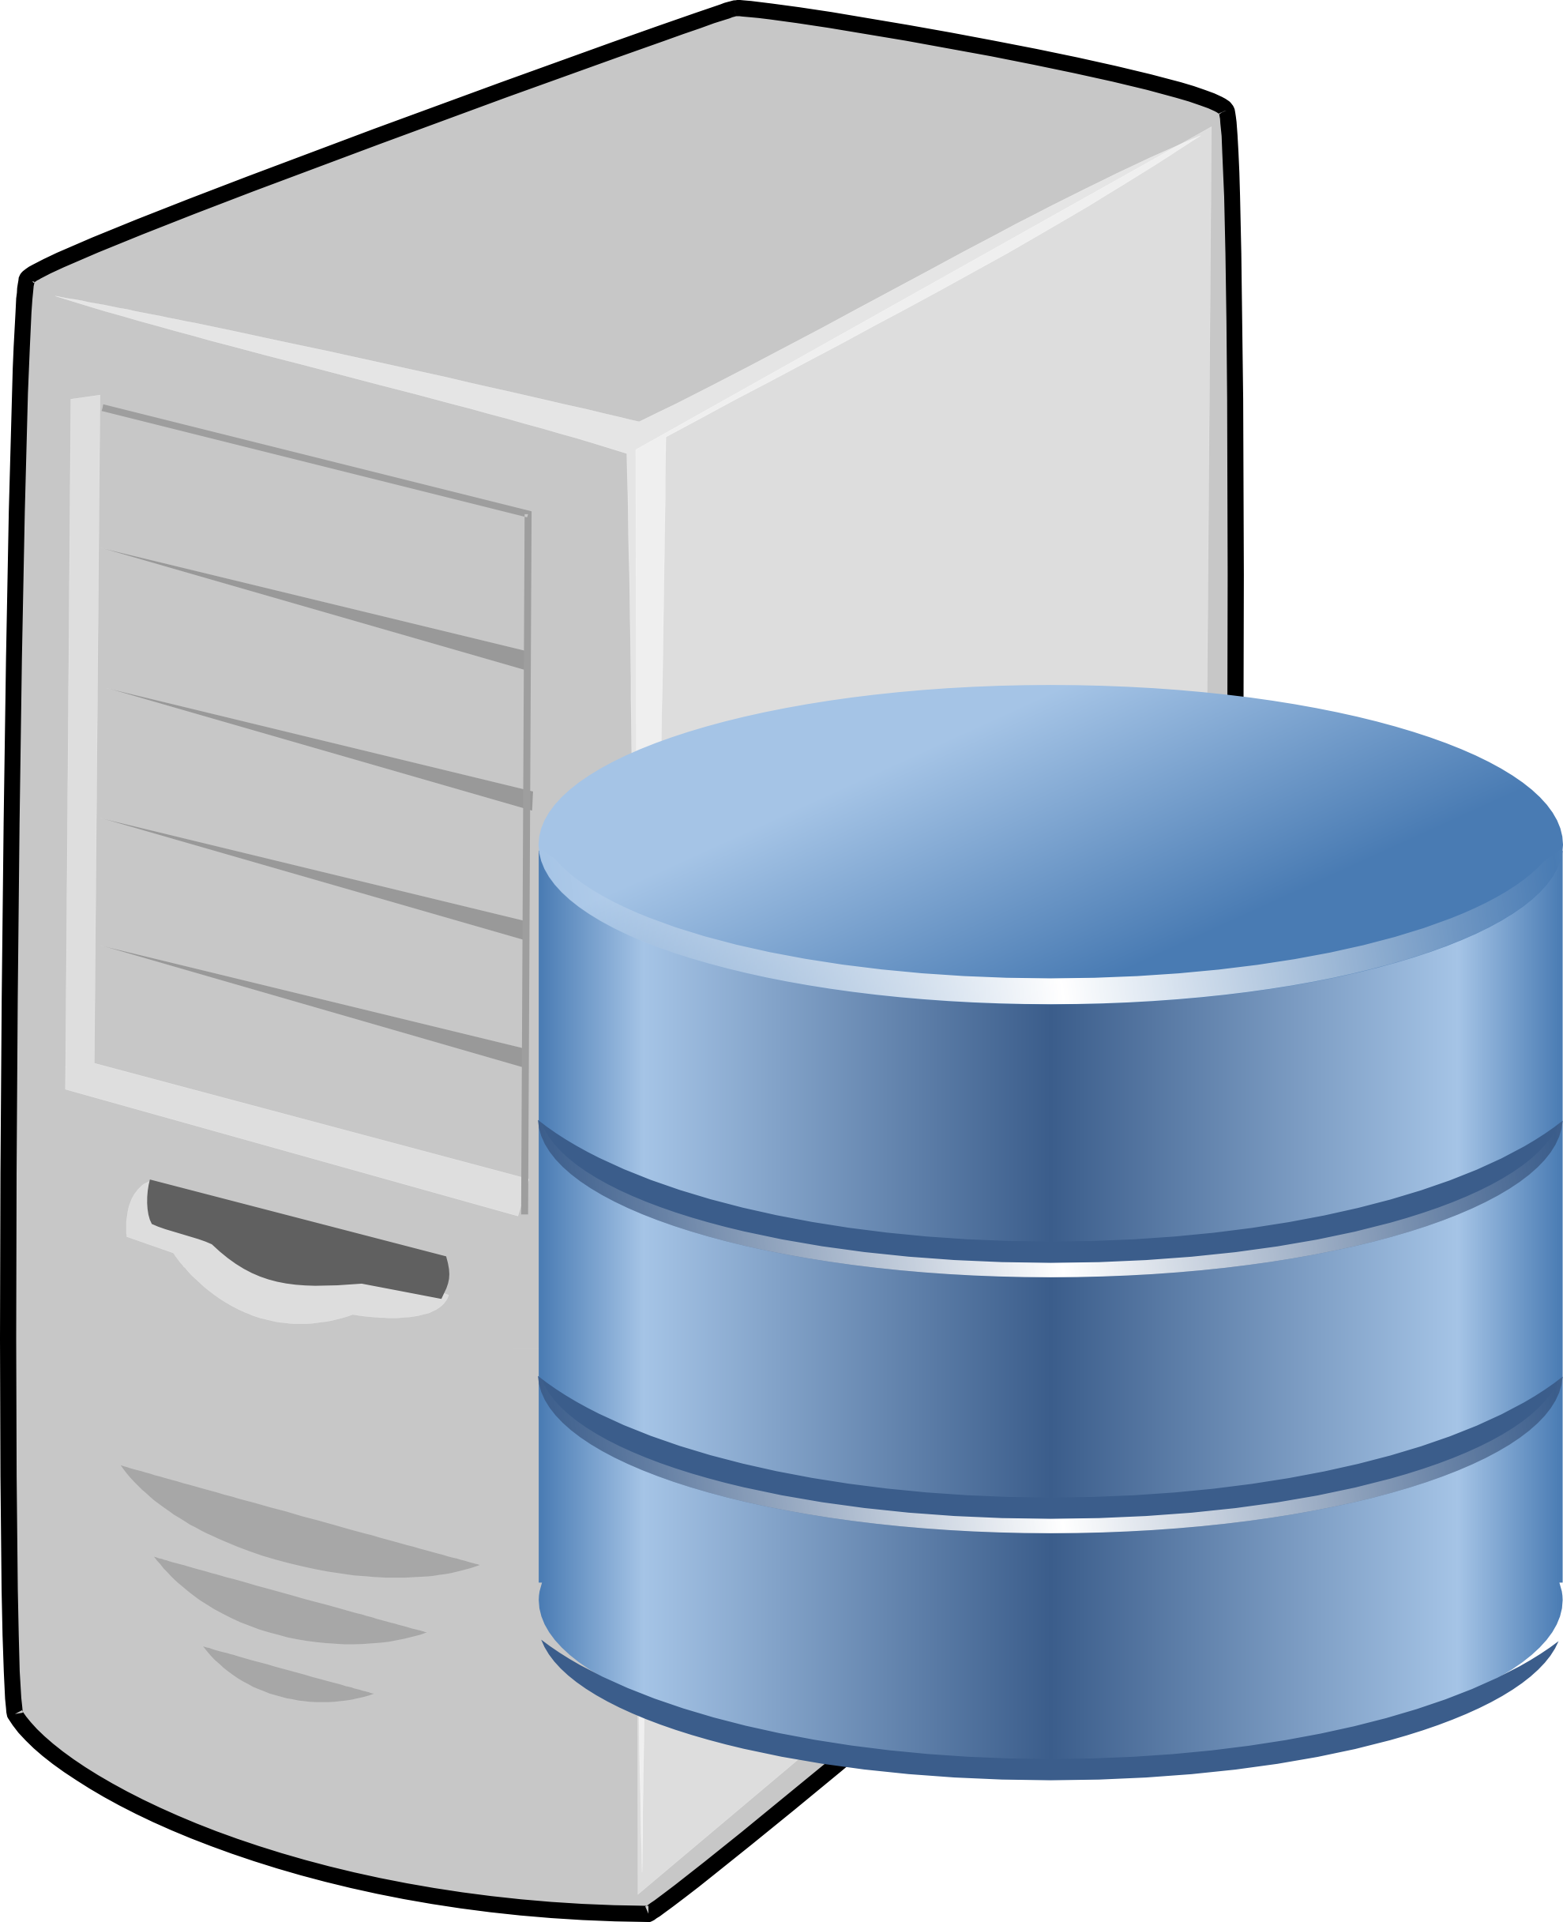
Data Layer
Database server and application programs necessary to access data
-----------------------------------------------------
All tracked/important company information: full company roster of account information, task information, work/overtime hours, restrictions/web browsing history, log of support access, staff contact details, client contact details

Slide 42
User Interface Designs

Slide 43
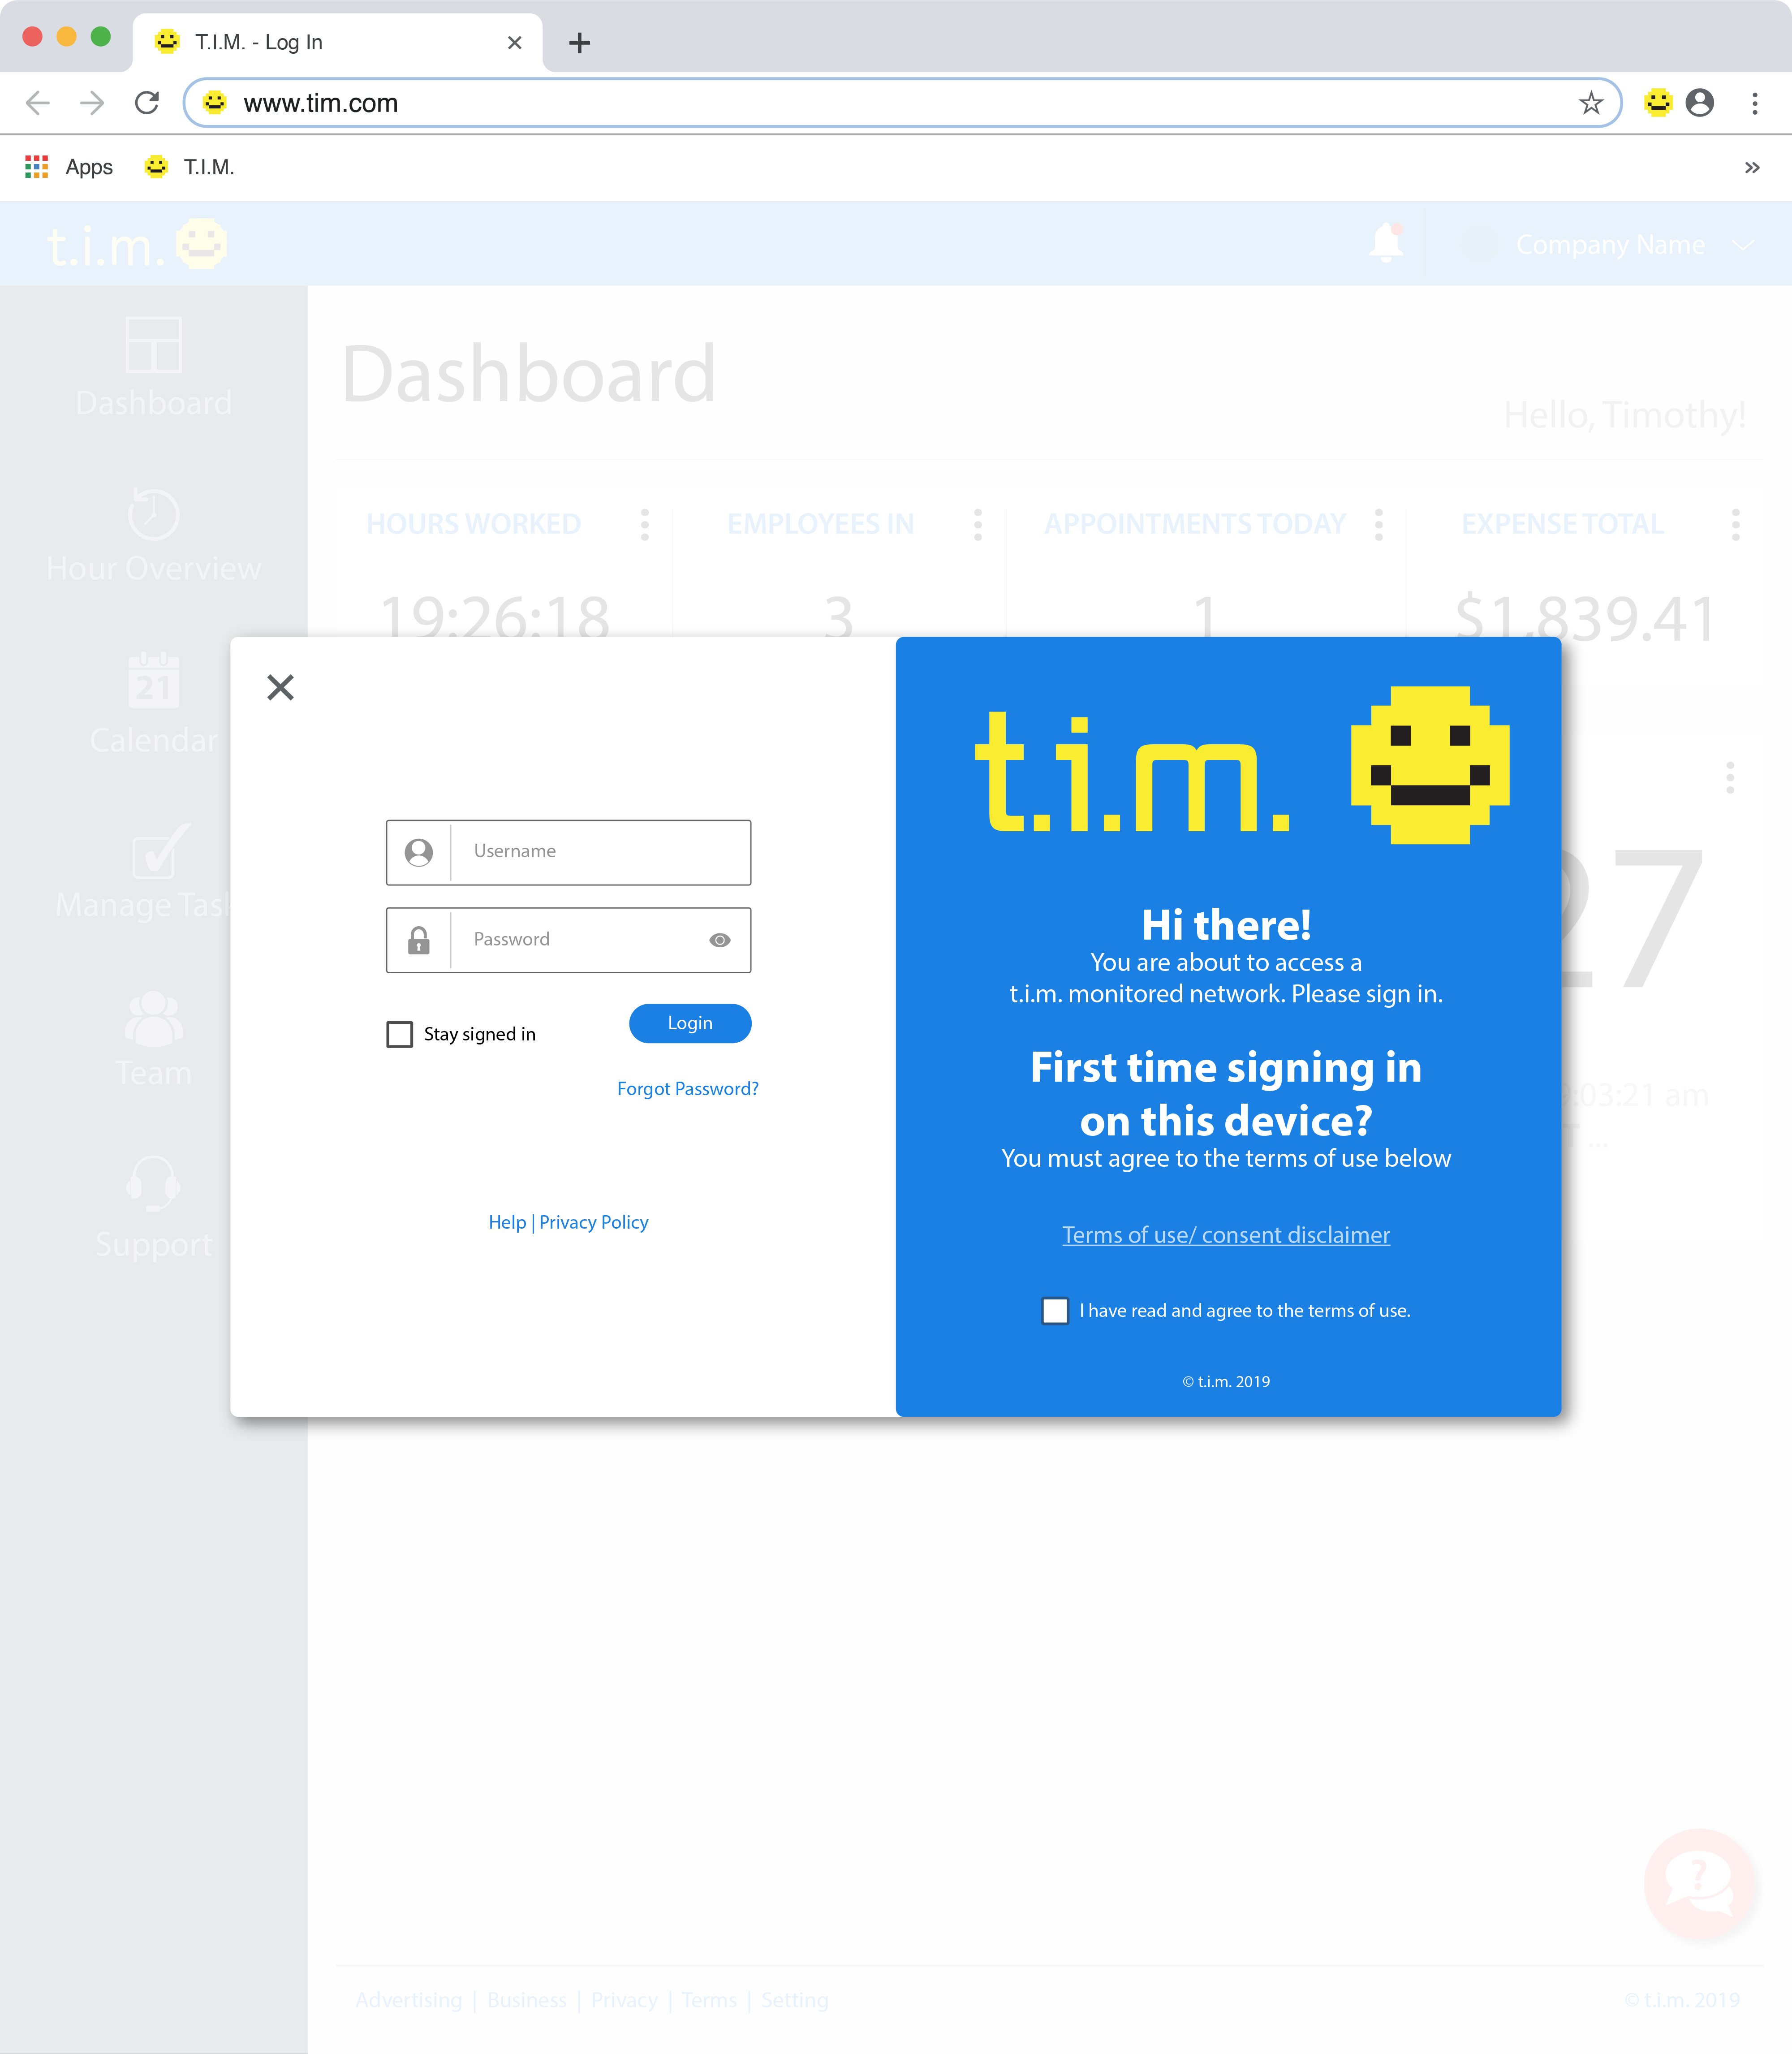

Slide 44
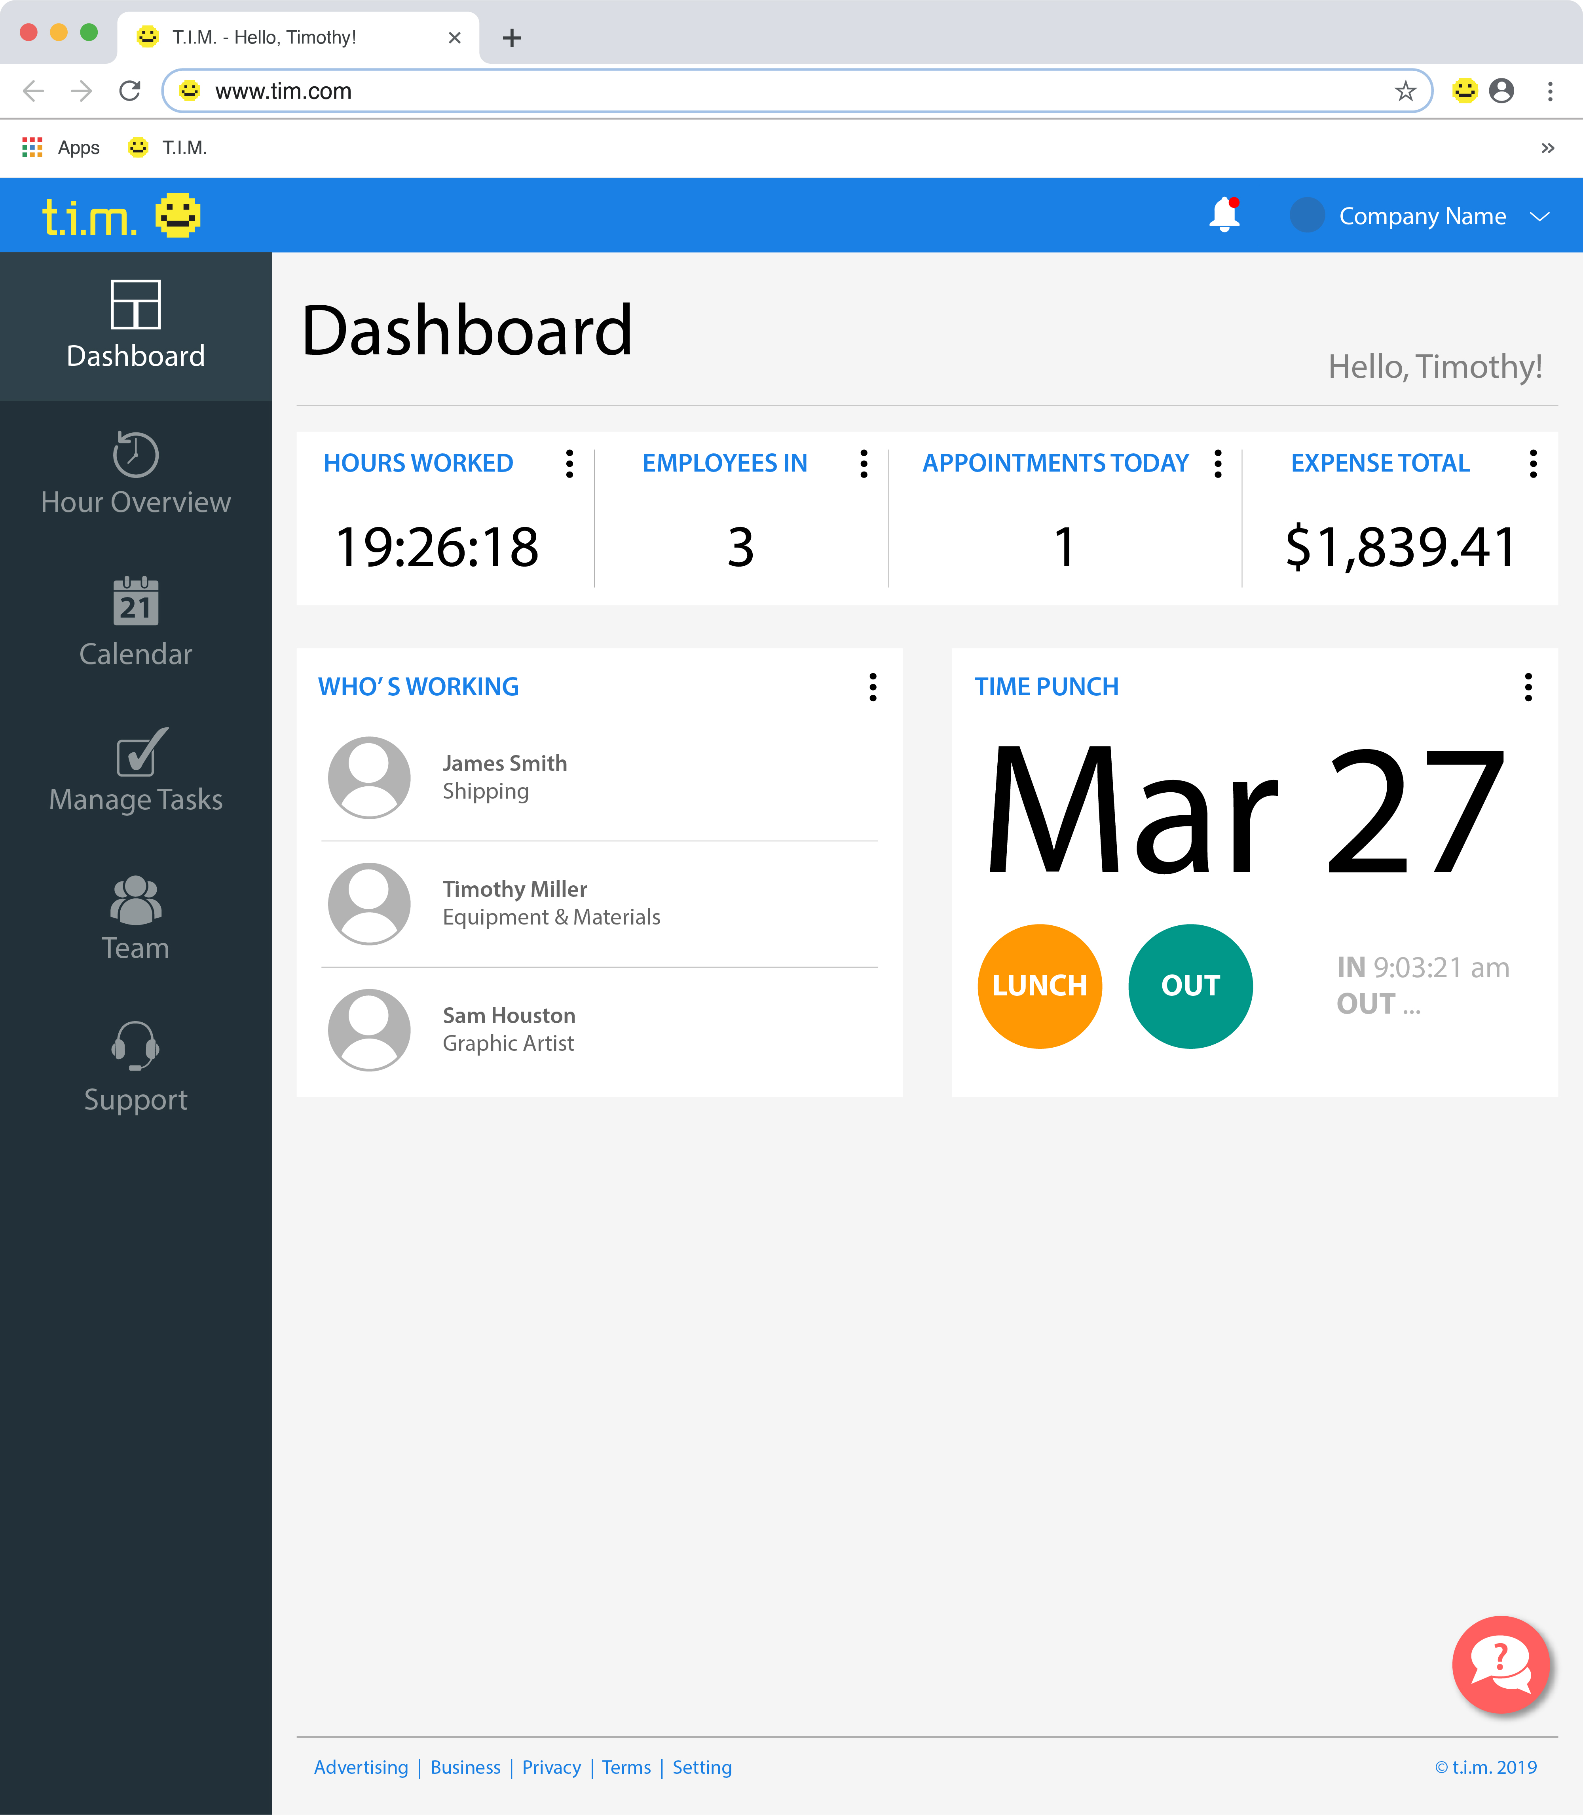

Slide 45
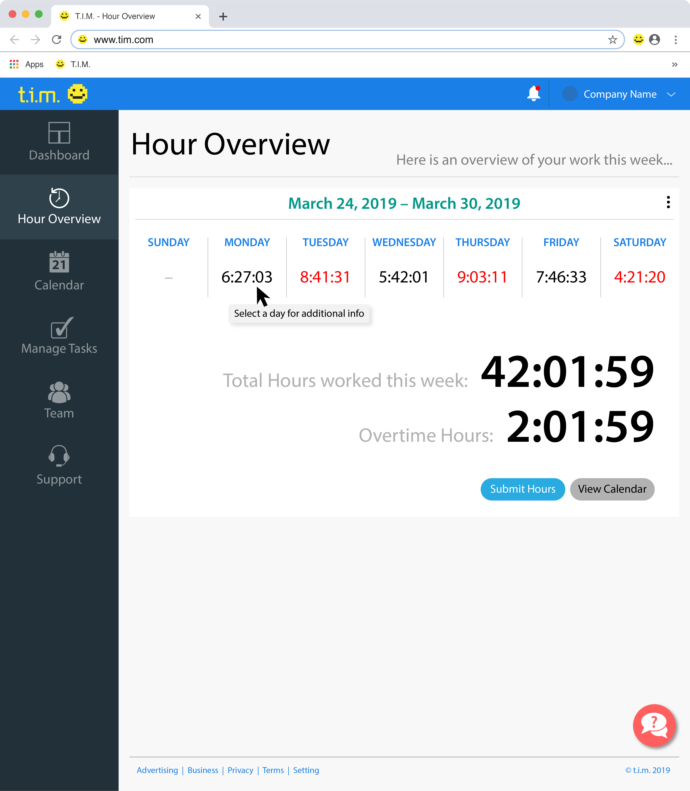

Slide 46
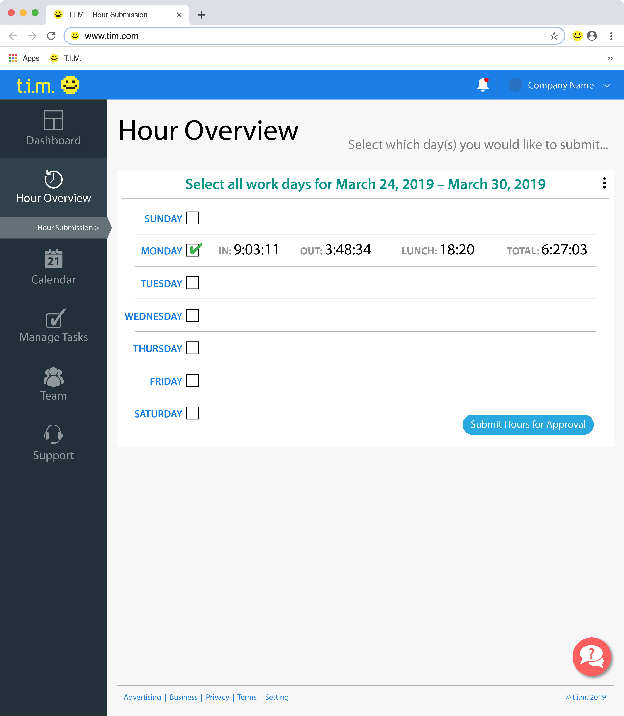

Slide 47
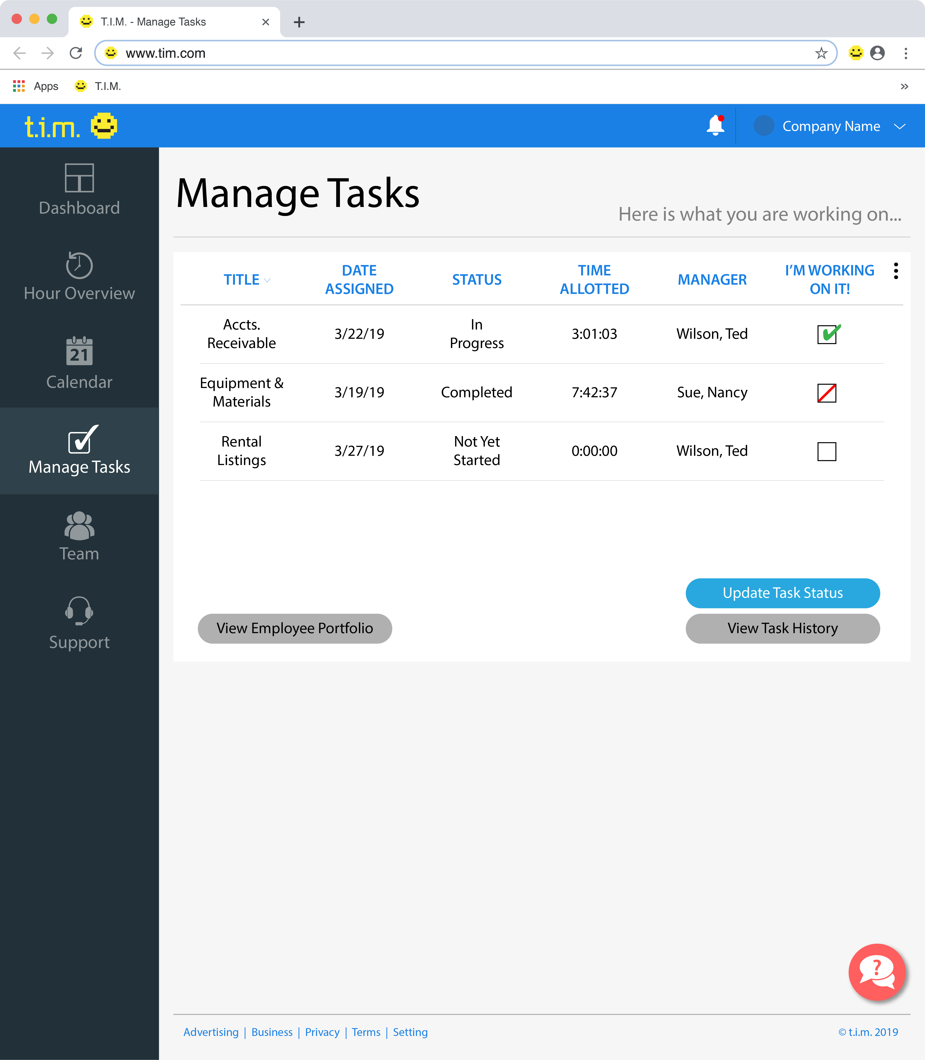

Slide 48
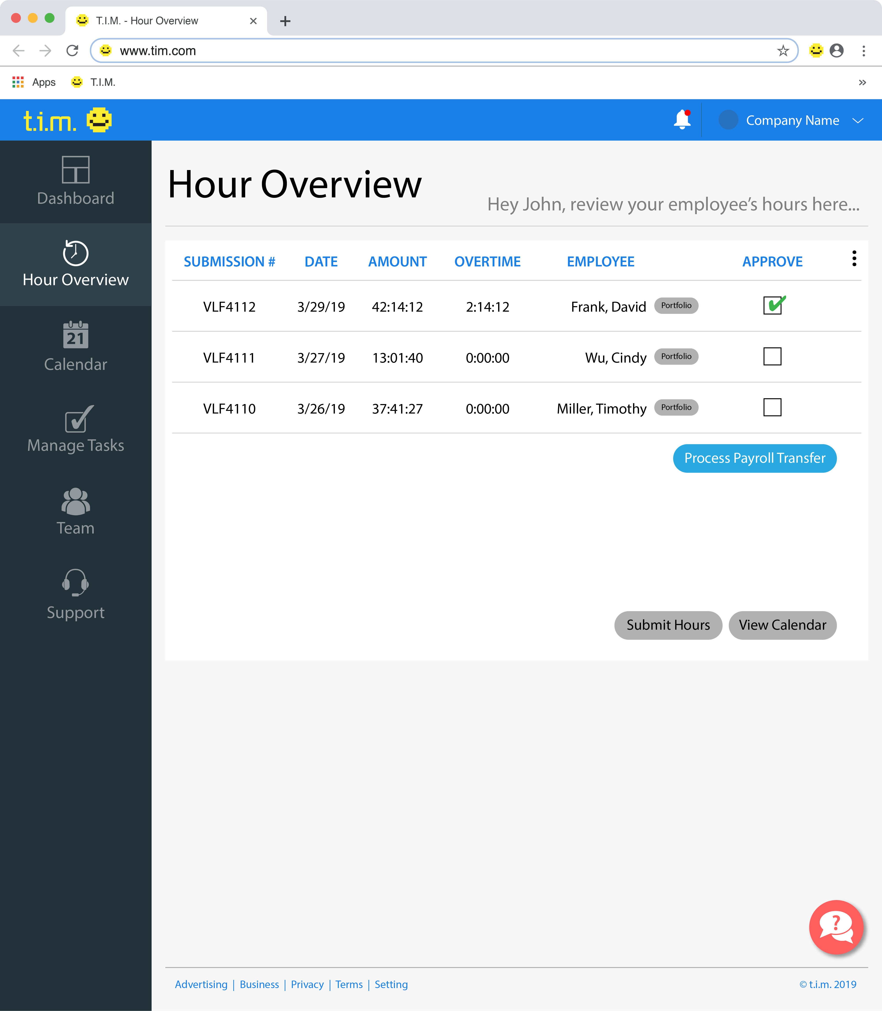

Slide 49
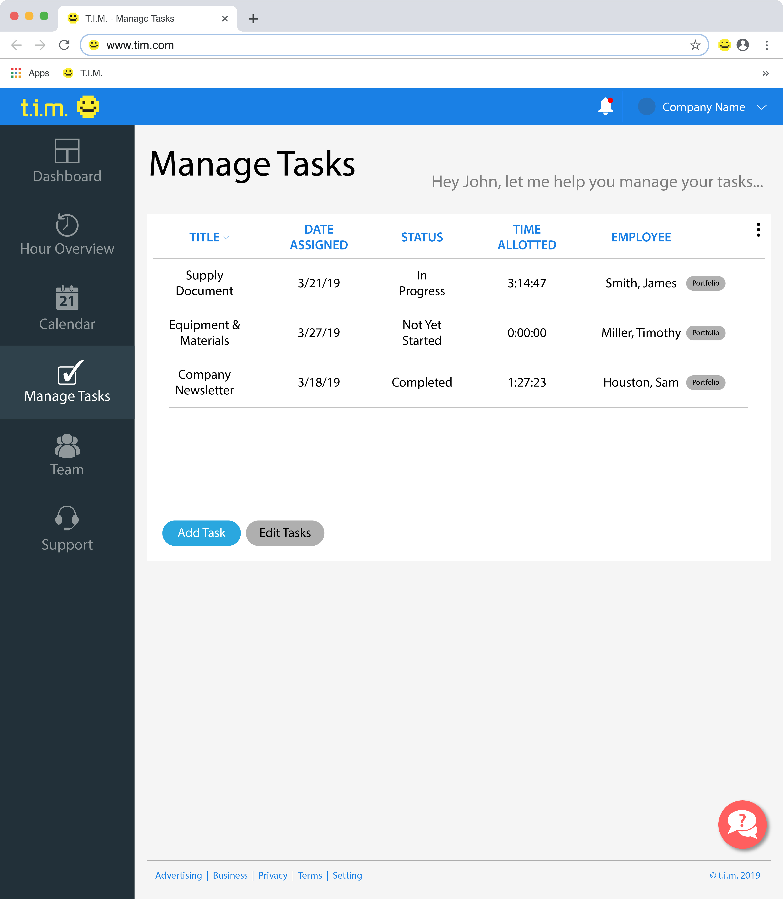

Slide 50
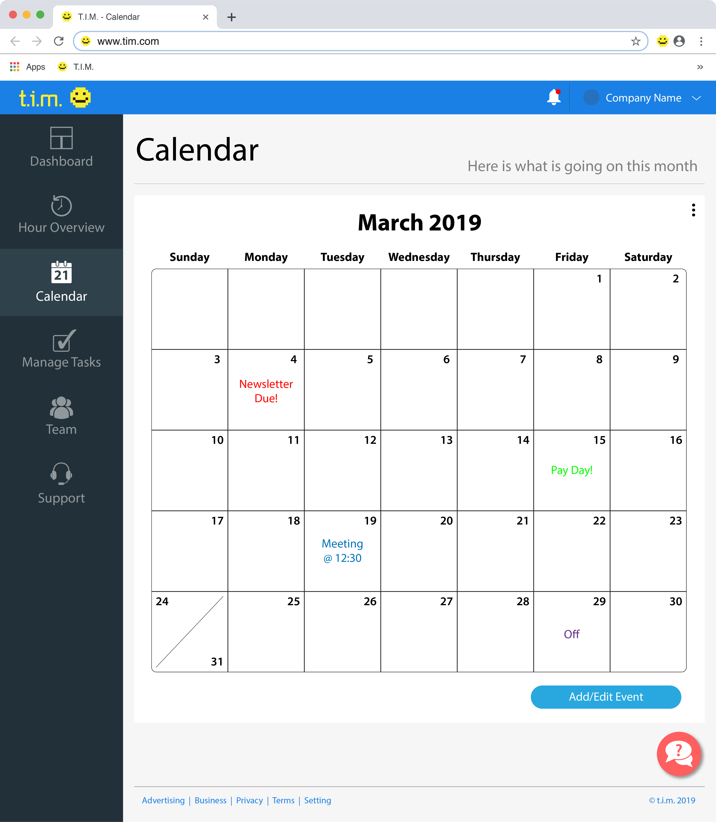

Slide 51
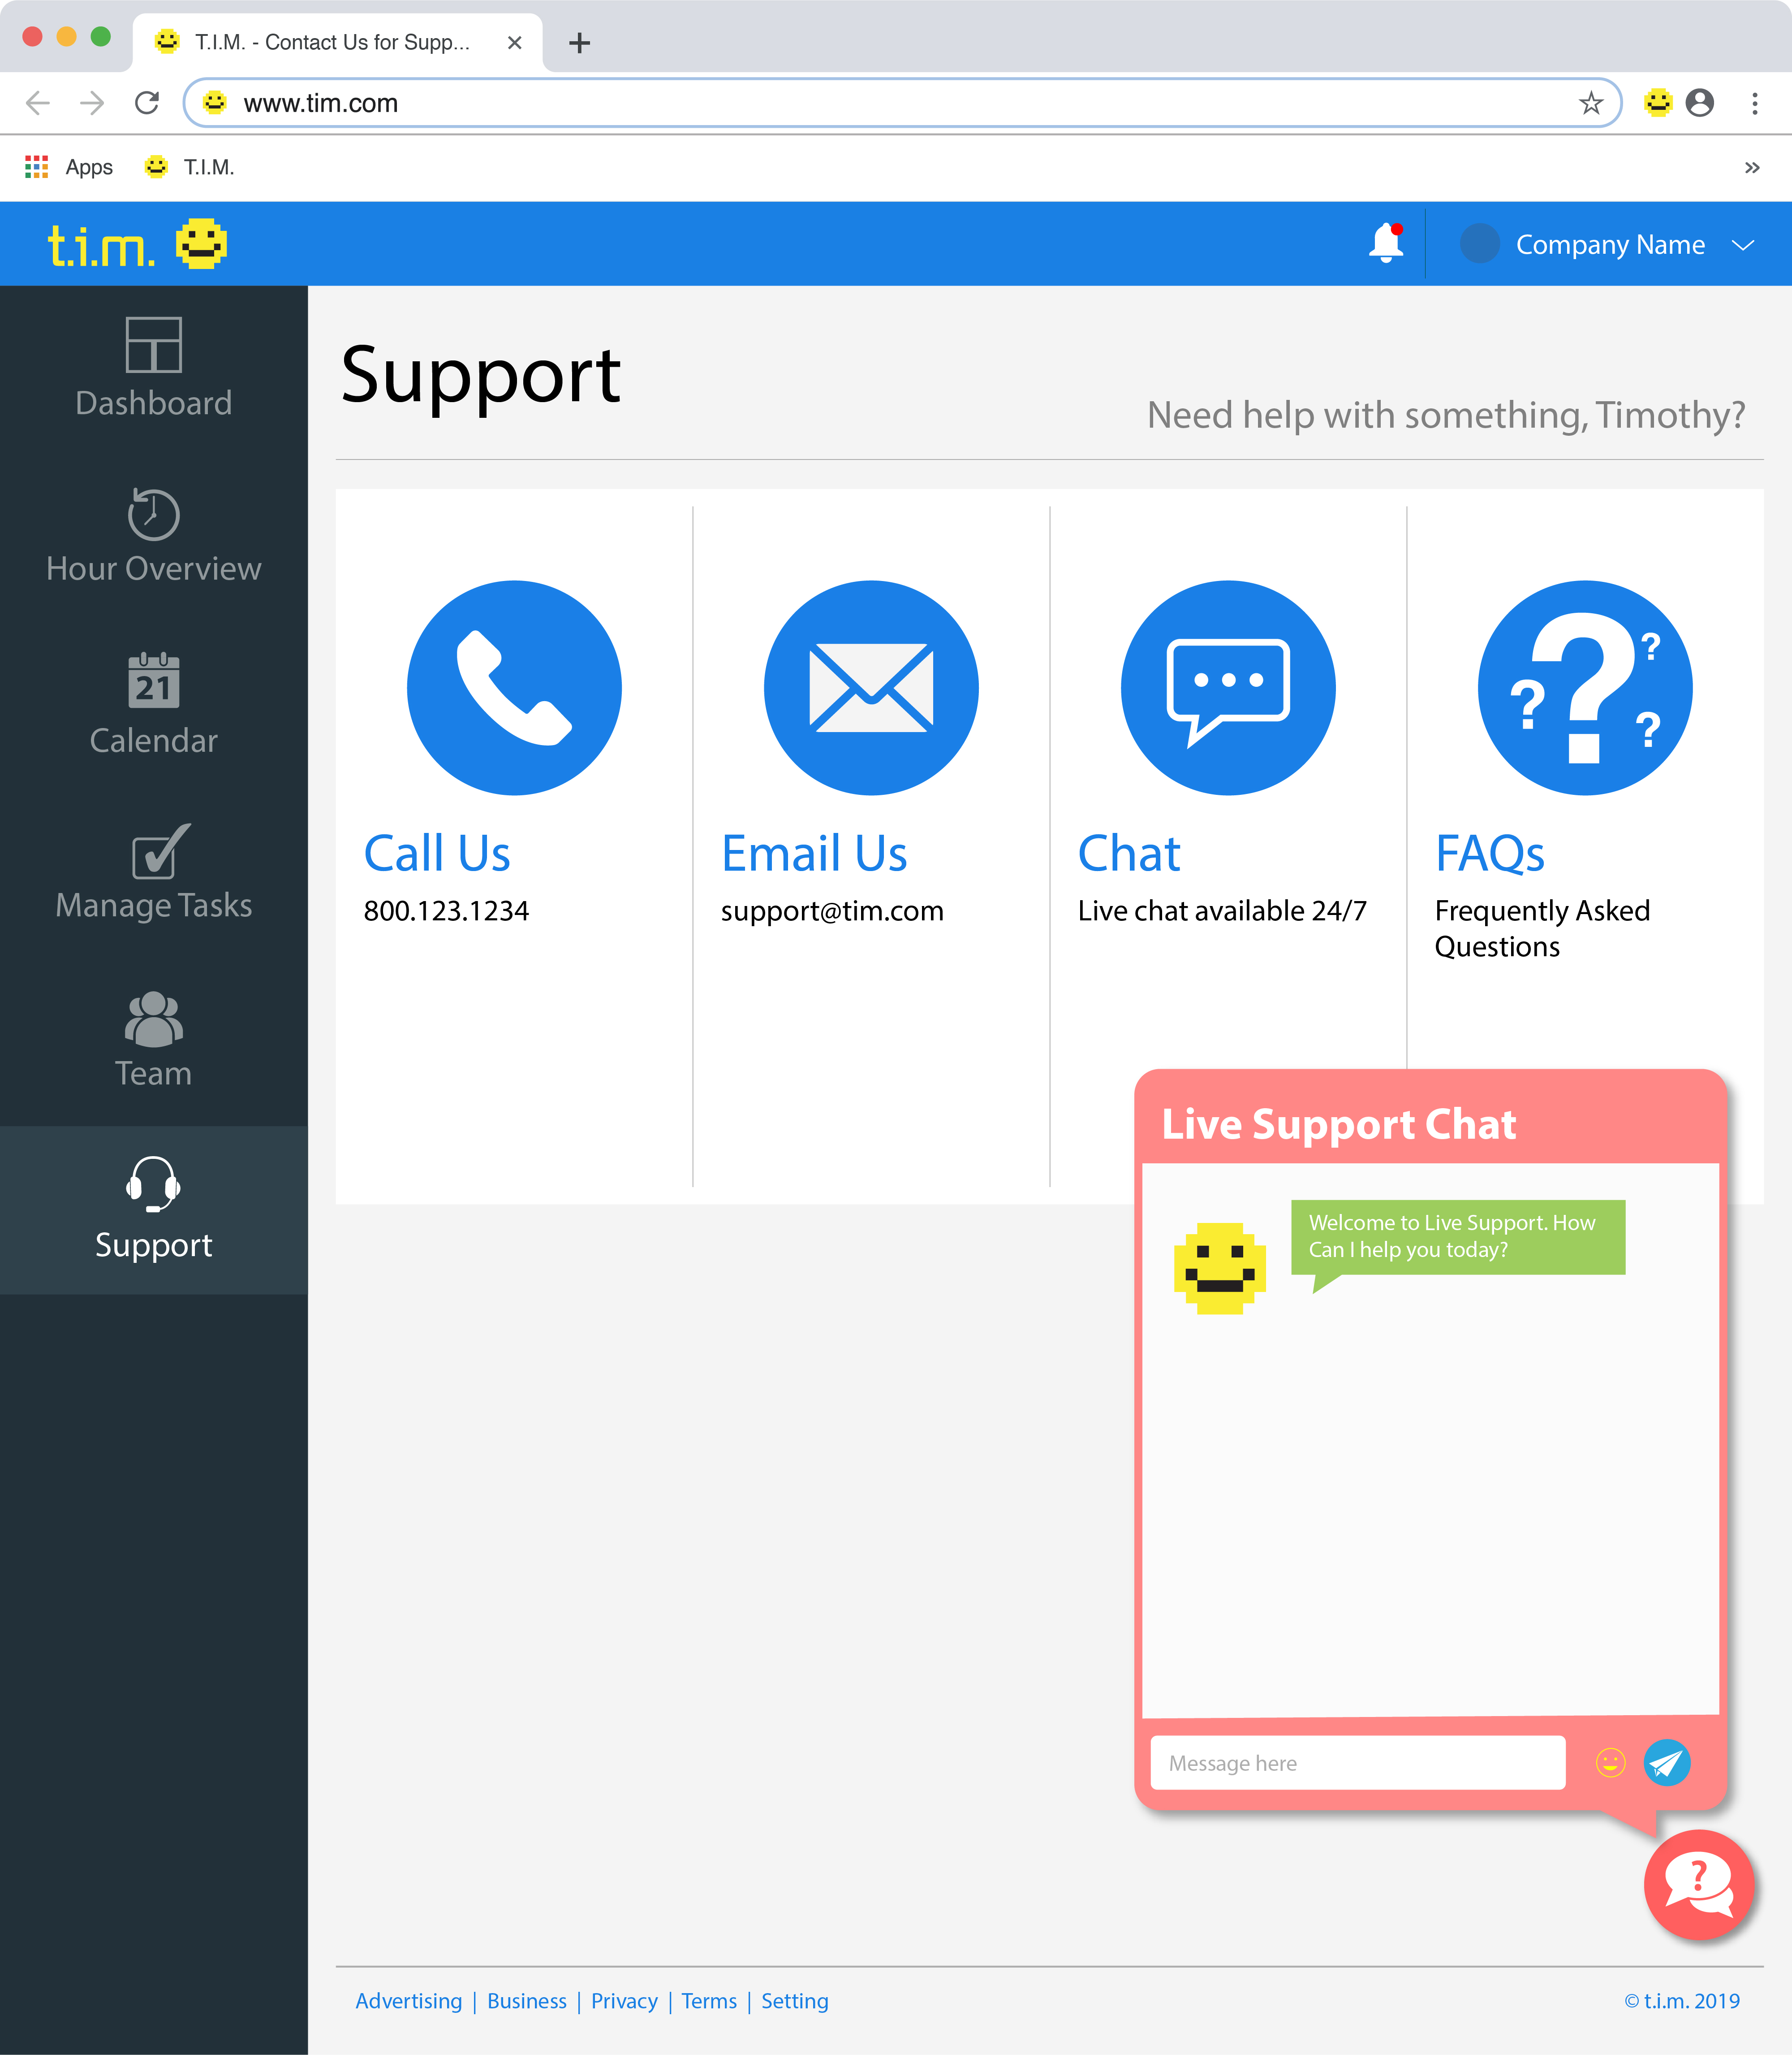

Slide 52
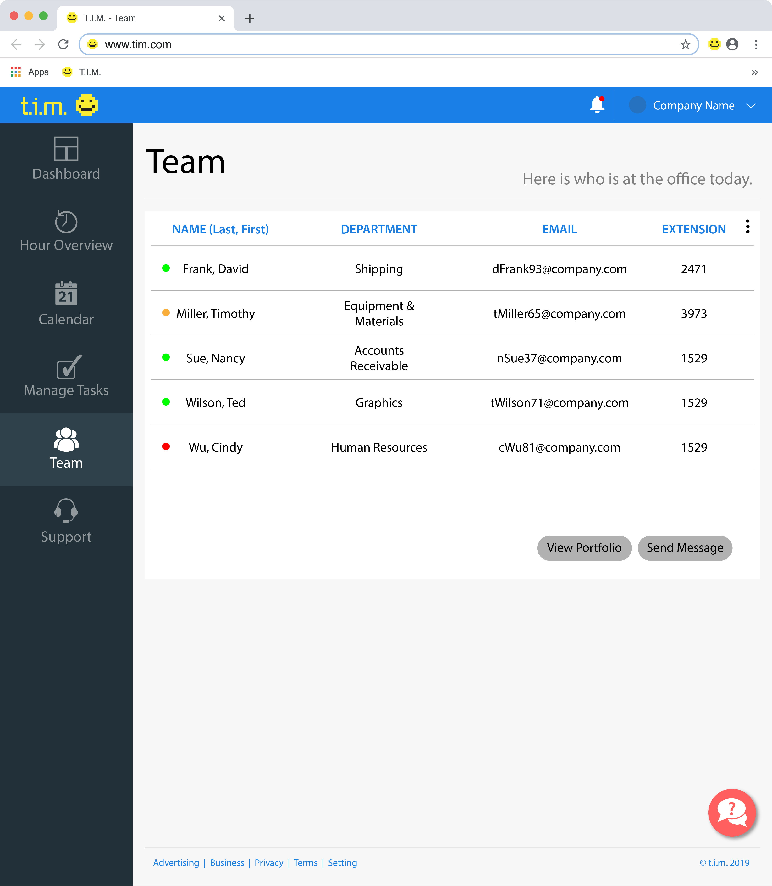

Slide 53
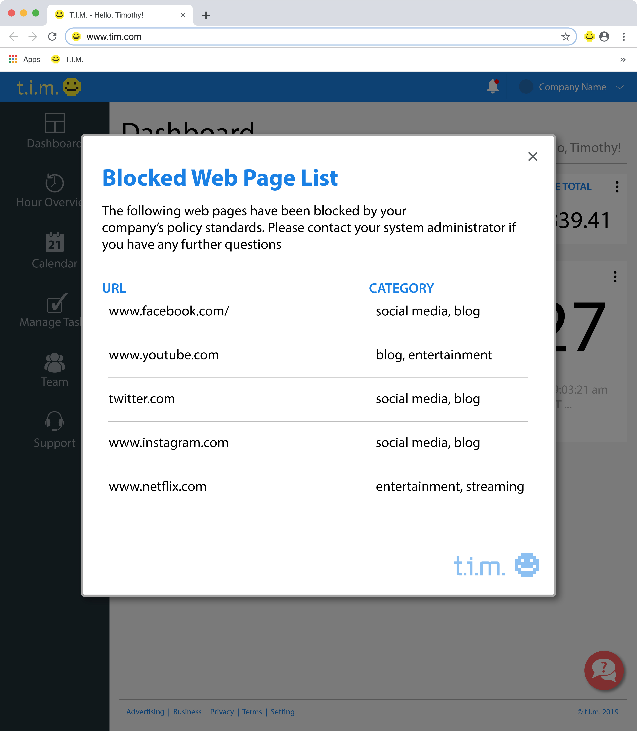

Slide 54
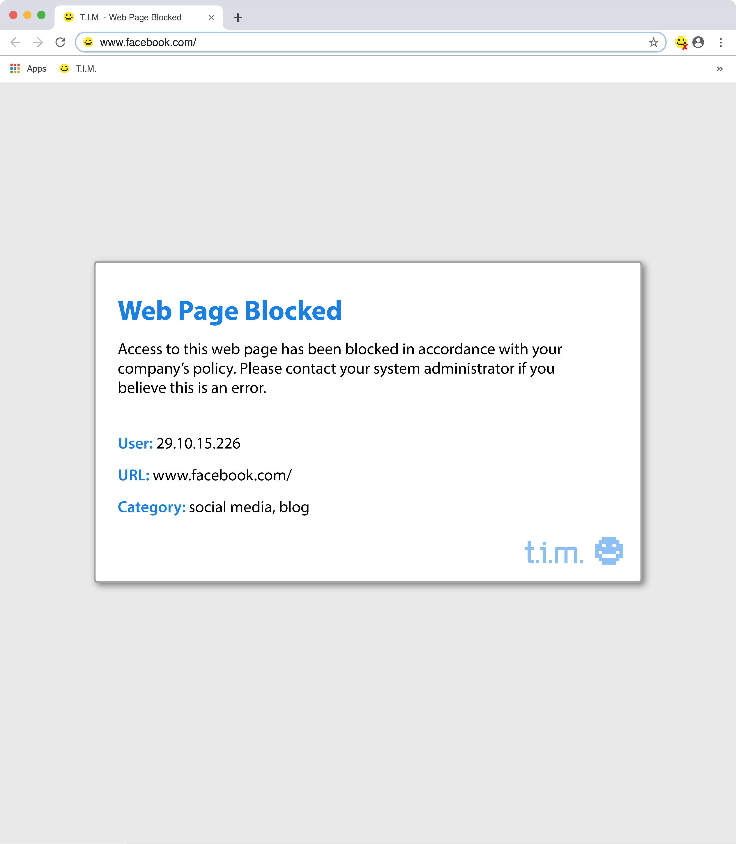

Slide 55
Database Designs

Slide 56
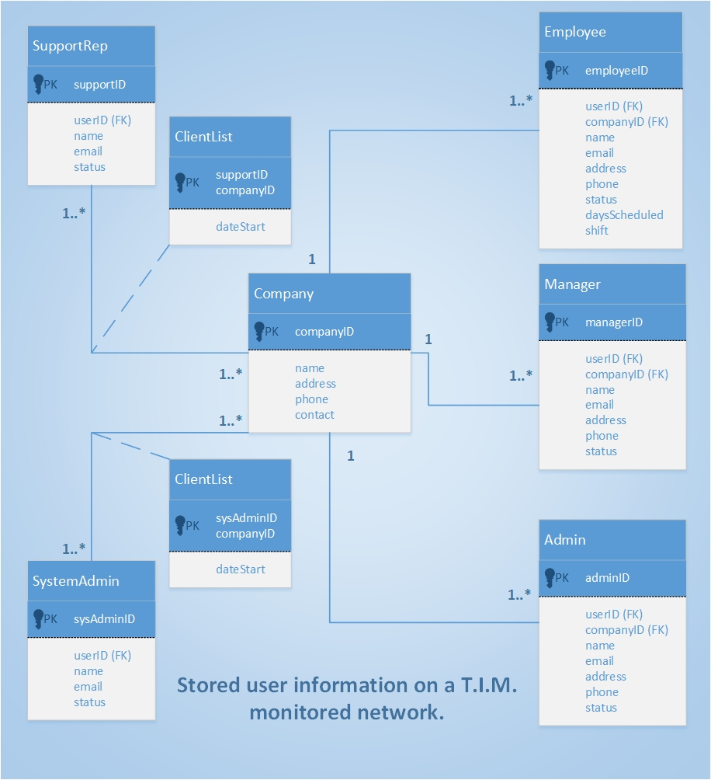

Slide 57
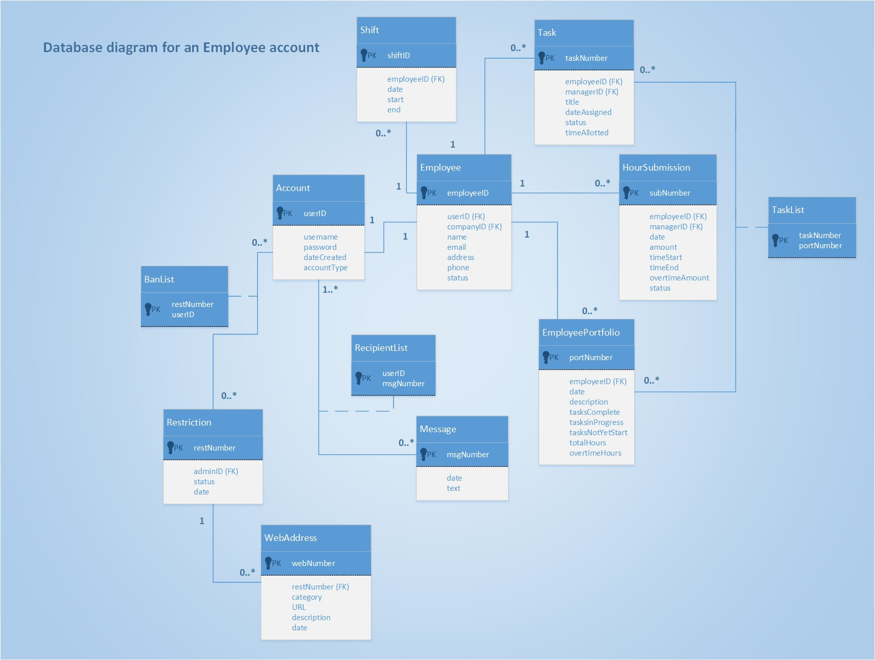

Slide 58
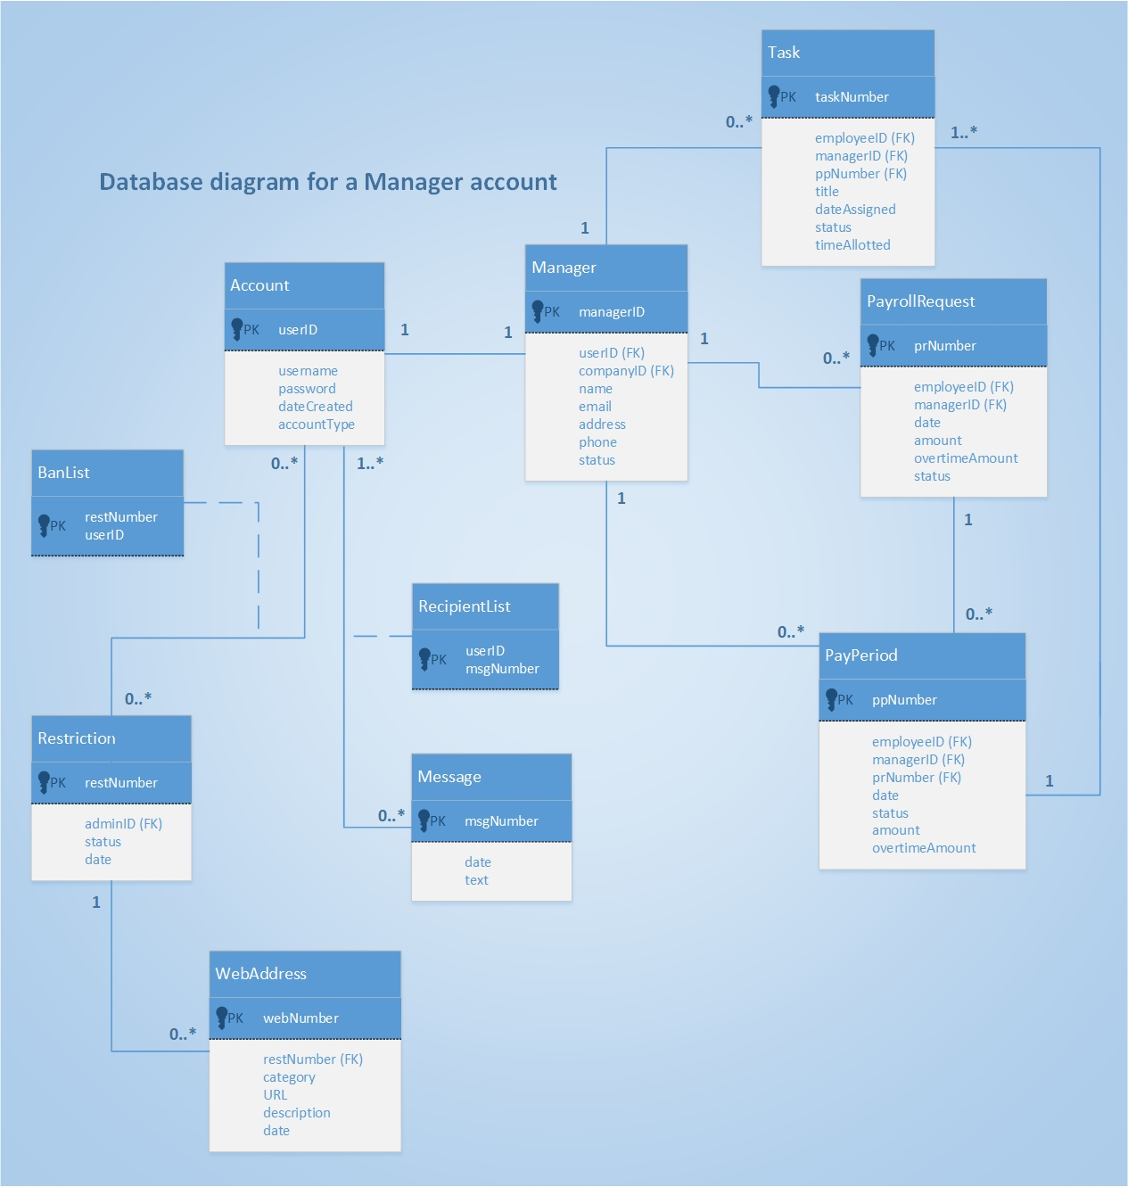

Slide 59
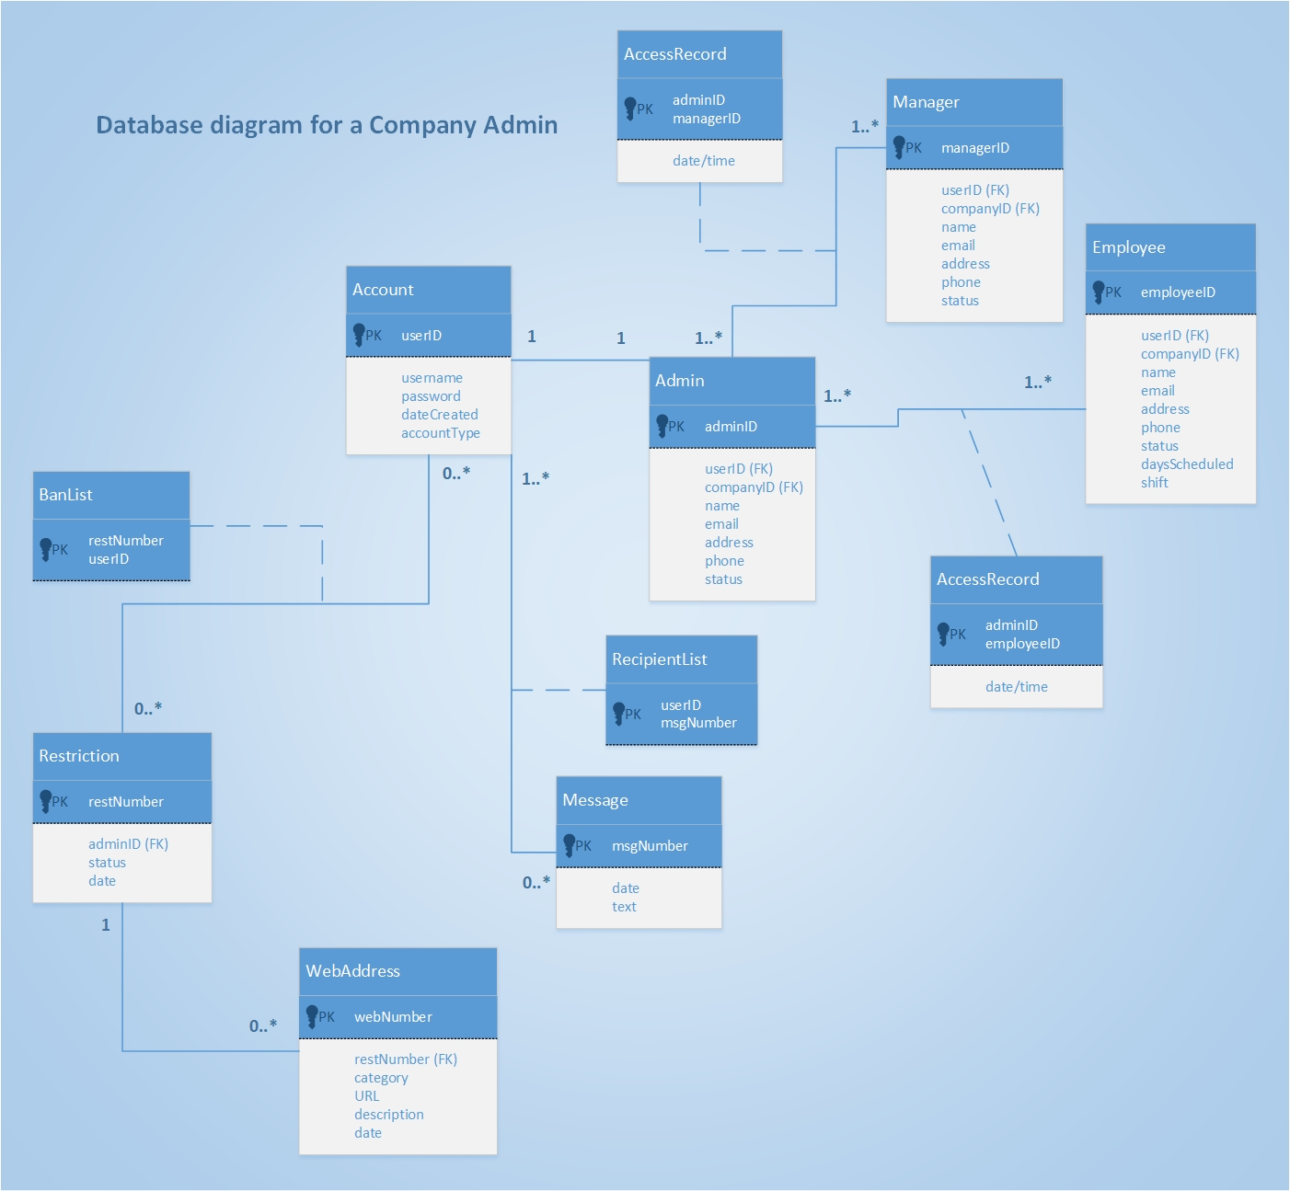

Slide 60
Design Class Diagrams & Sequence Diagrams

Slide 61
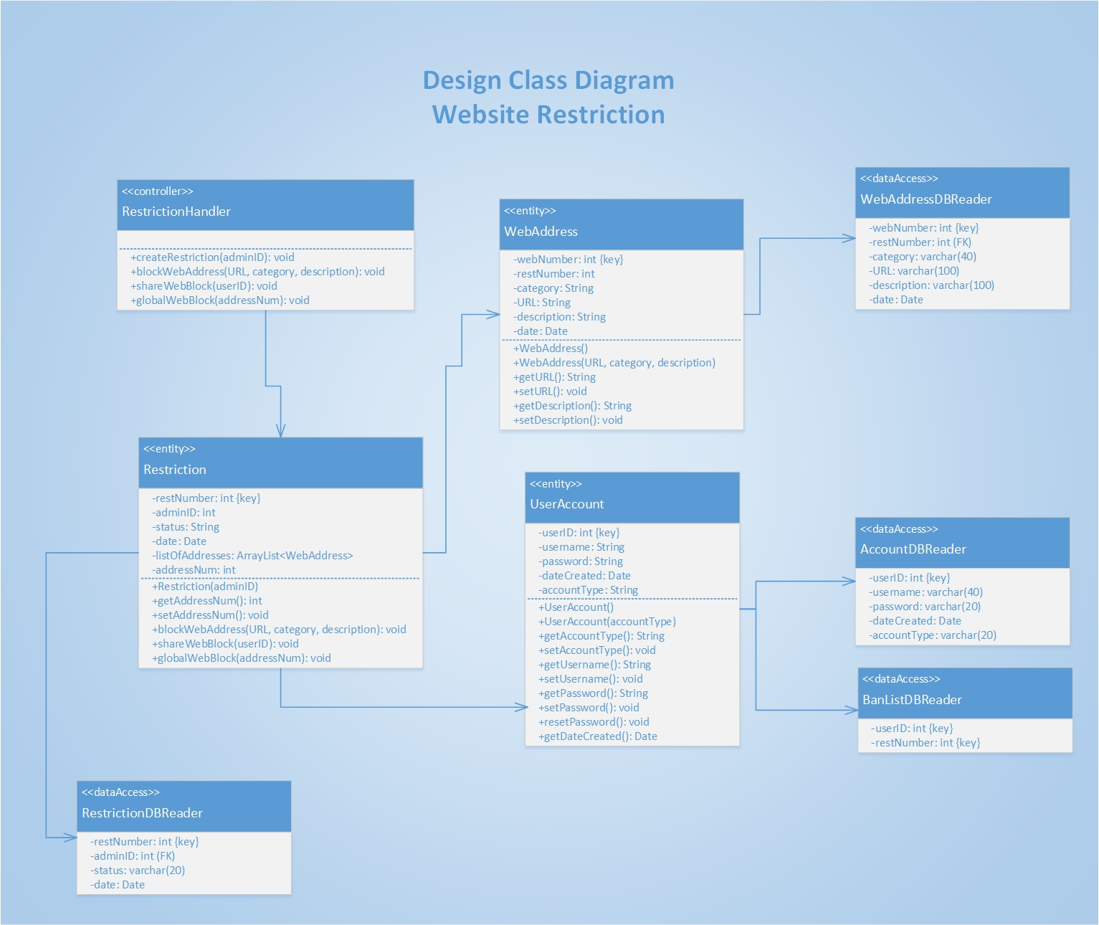

Slide 62
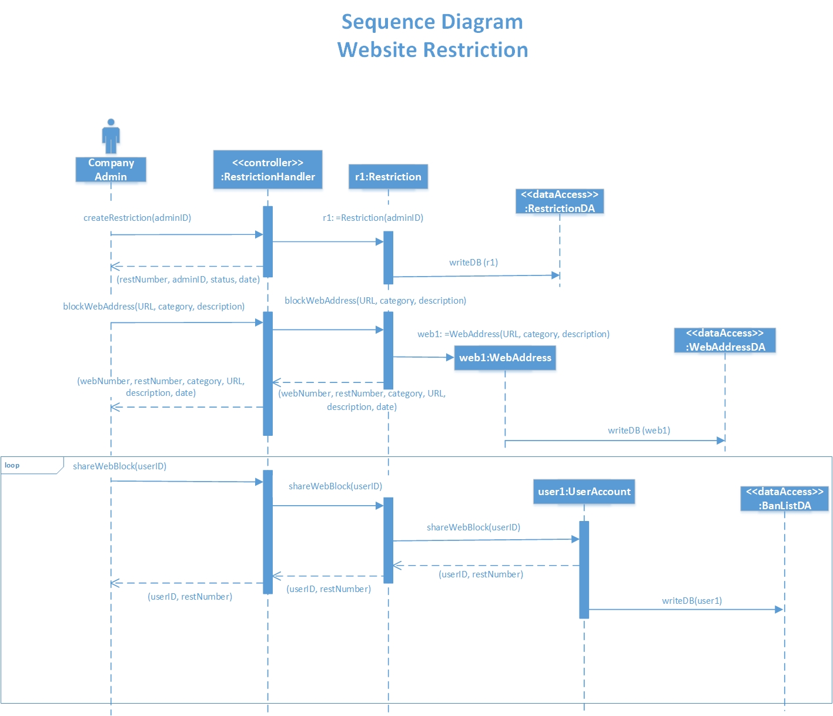

Slide 63
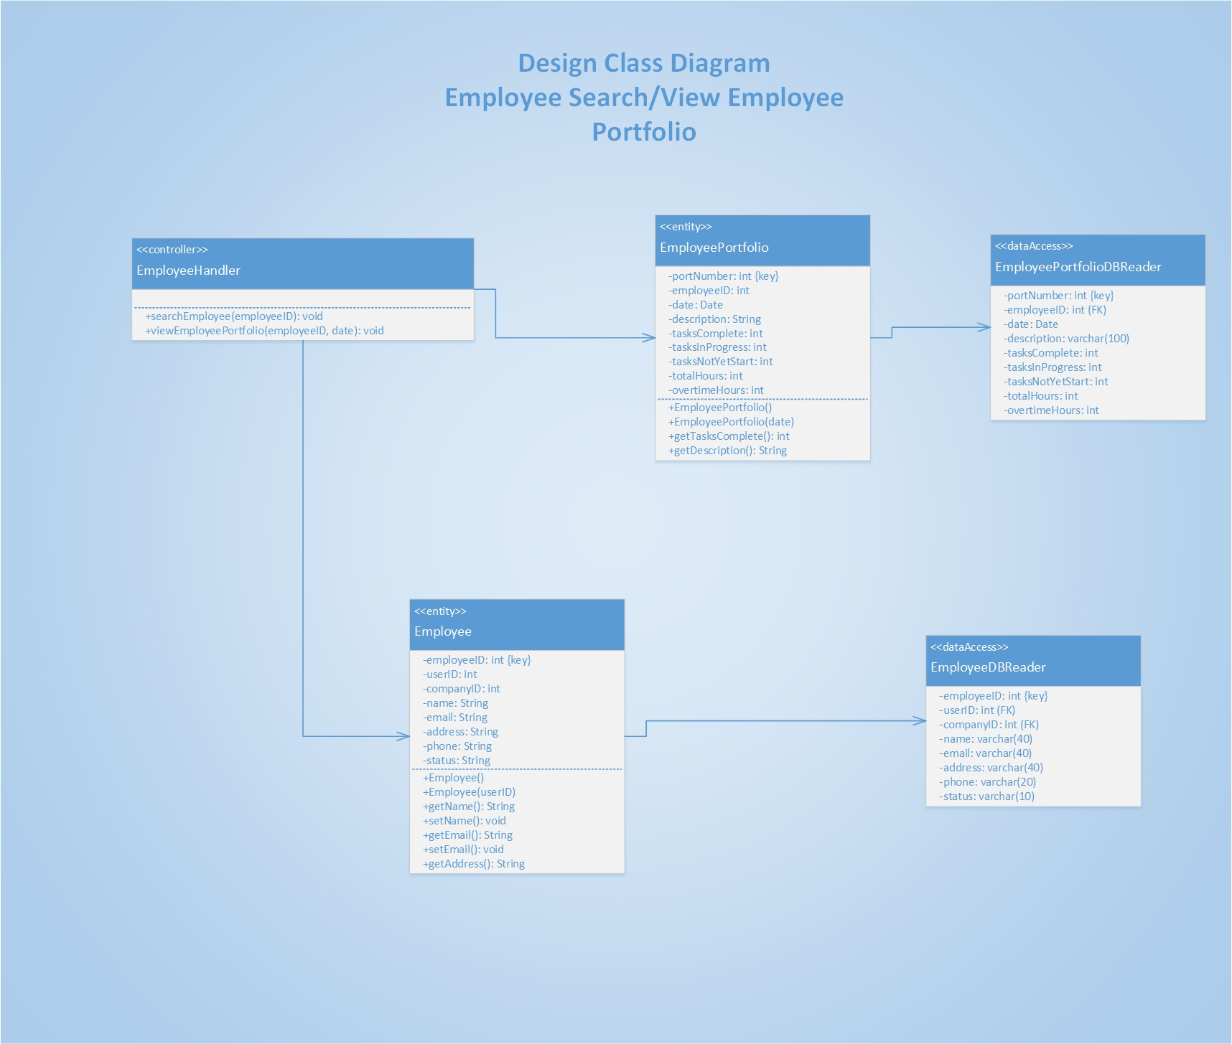

Slide 64
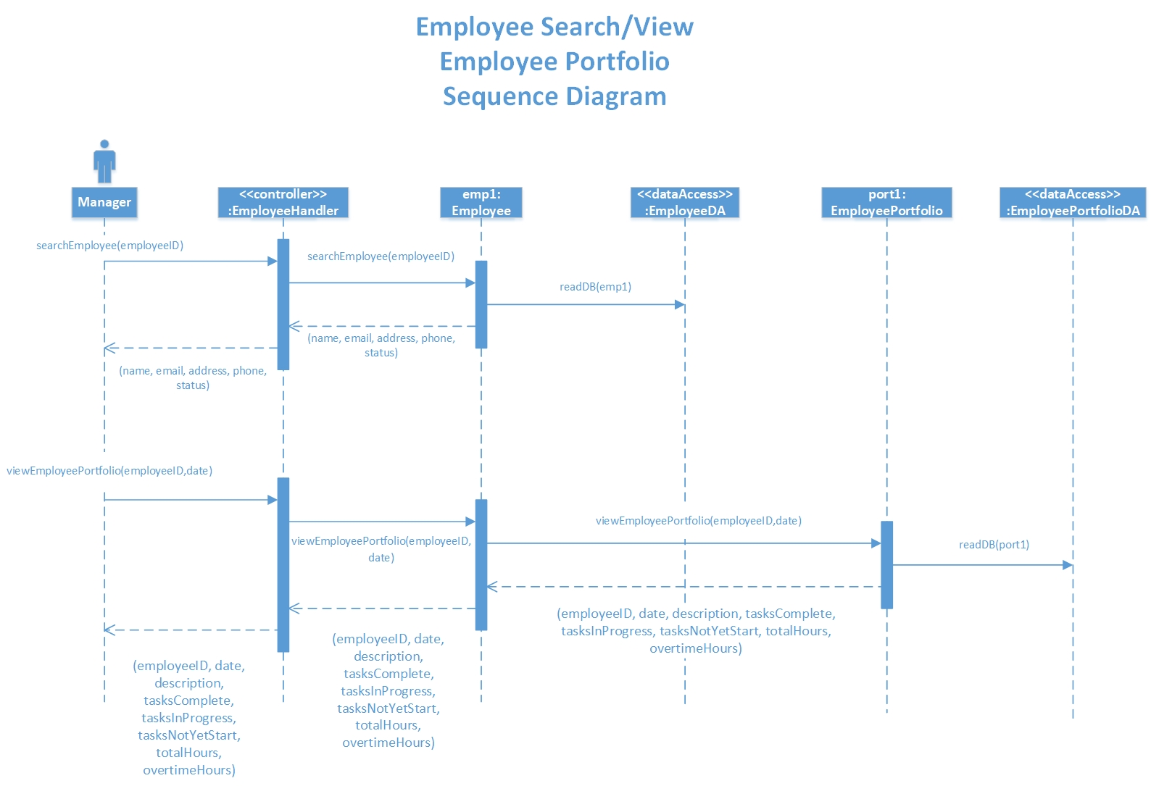

Slide 65
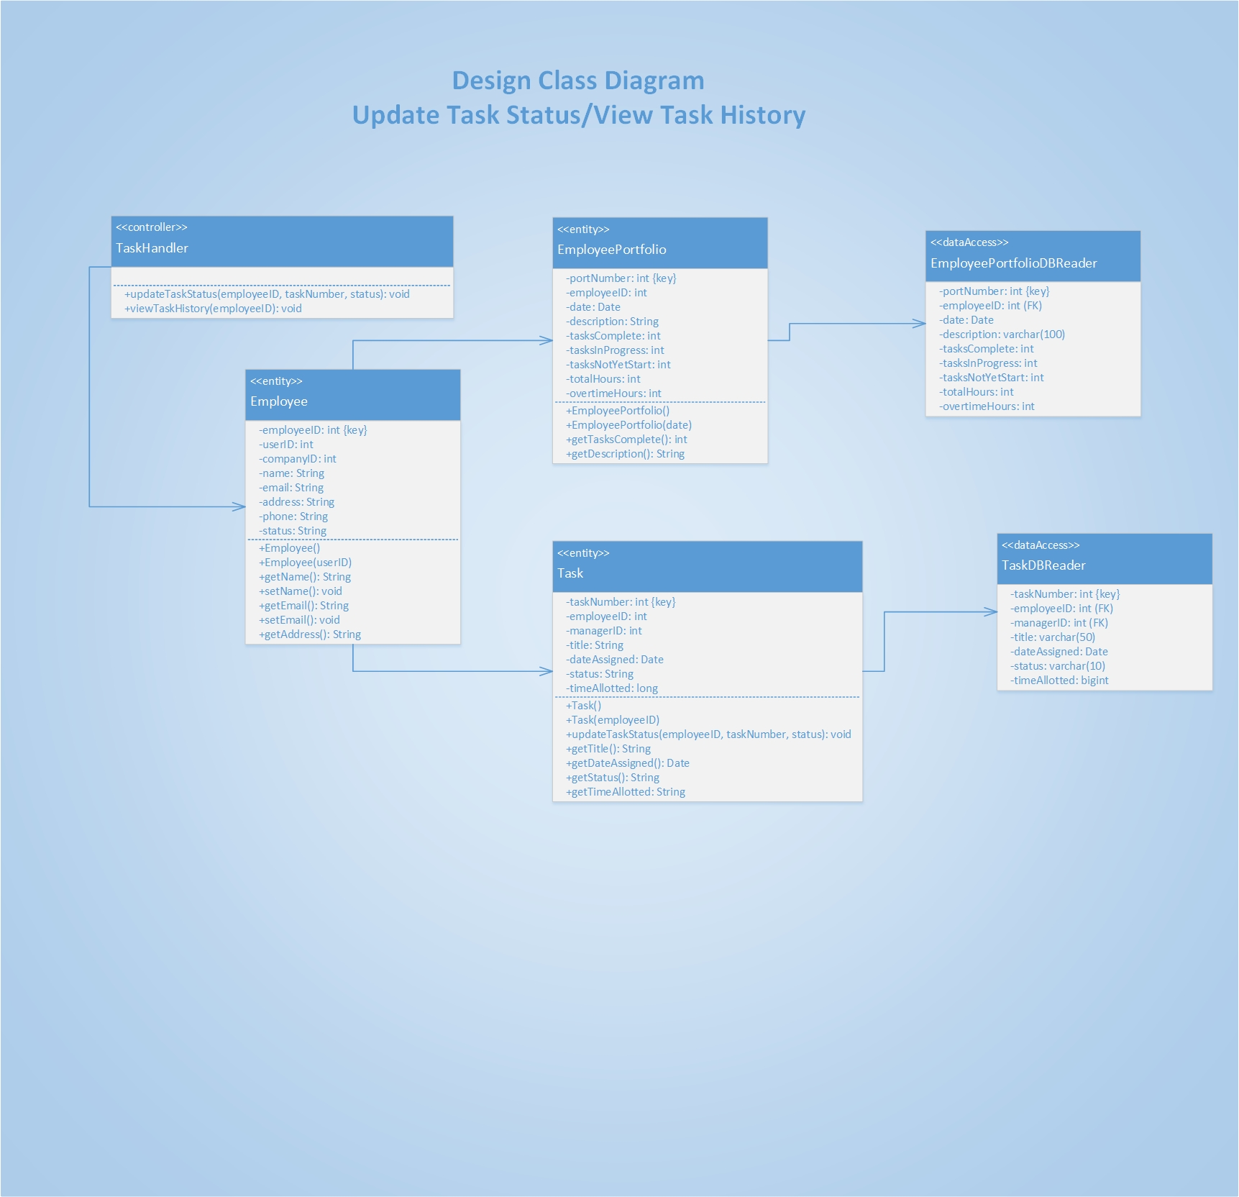

Slide 66
